Slide 1

Collective Worship - ‘Day 4’, Plan 1

Slide 2

Recap
Recently, we thought deeply within collective worship about a biblical creation story – Genesis 1. For thousands of years, the creation narrative of Genesis 1 has been read by millions of people. Some of the main messages taken are…
…that the world has been created by God. God chose to create plants, animals, humans, birdlife, sealife, land and sky.
…and this creation is good! The world is full of so much beauty, amazing life and places.

Slide 3





Recap
We then thought about two different Christian views about the place of humans in creation. Much of this thinking is based around this bible verse:
God spoke: “Let us make human beings in our image, make them reflecting our nature so they can be responsible for the fish in the sea, the birds in the air, the cattle, and, yes, Earth itself, and every animal that moves on the face of Earth.” (Genesis 1: 26, The Message version)
God
God
Dominion worldview
‘Community of creation’ worldview

Slide 4
Recap
We then thought about why these views are important to think about in the light of climate change.
Which view below did you think was better for responding to climate change and showing a heart for the earth?
God
God
Dominion worldview
‘Community of creation’ worldview

Slide 5





So far in our ‘Heart for the Earth’ thinking, we have used the first three days of the Genesis story to help us think about wise use of electricity, water and ecology. On Day 4 of this creation story, God creates the sun, moon and stars. The sun and our carbon footprint will be the focus of our thinking in collective worship.

Slide 6

In the creation narrative of Genesis 1, God follows the creation of light, water and plant-life to create the sun, moon and stars on the fourth day:
Then God commanded, “Let lights appear in the sky to separate day from night and to show the time when days, years, and religious festivals begin;
they will shine in the sky to give light to the earth” – and it was done. So God made the two larger lights, the sun to rule over the day and the moon to rule over the night; he also made the stars. He placed the lights in the sky to shine on the earth, to rule over the day and the night, and to separate light from darkness. And God was pleased with what he saw. Evening passed and morning came – that was the fourth day.
(Genesis 1: 14-19, Good News Translation)

Slide 7
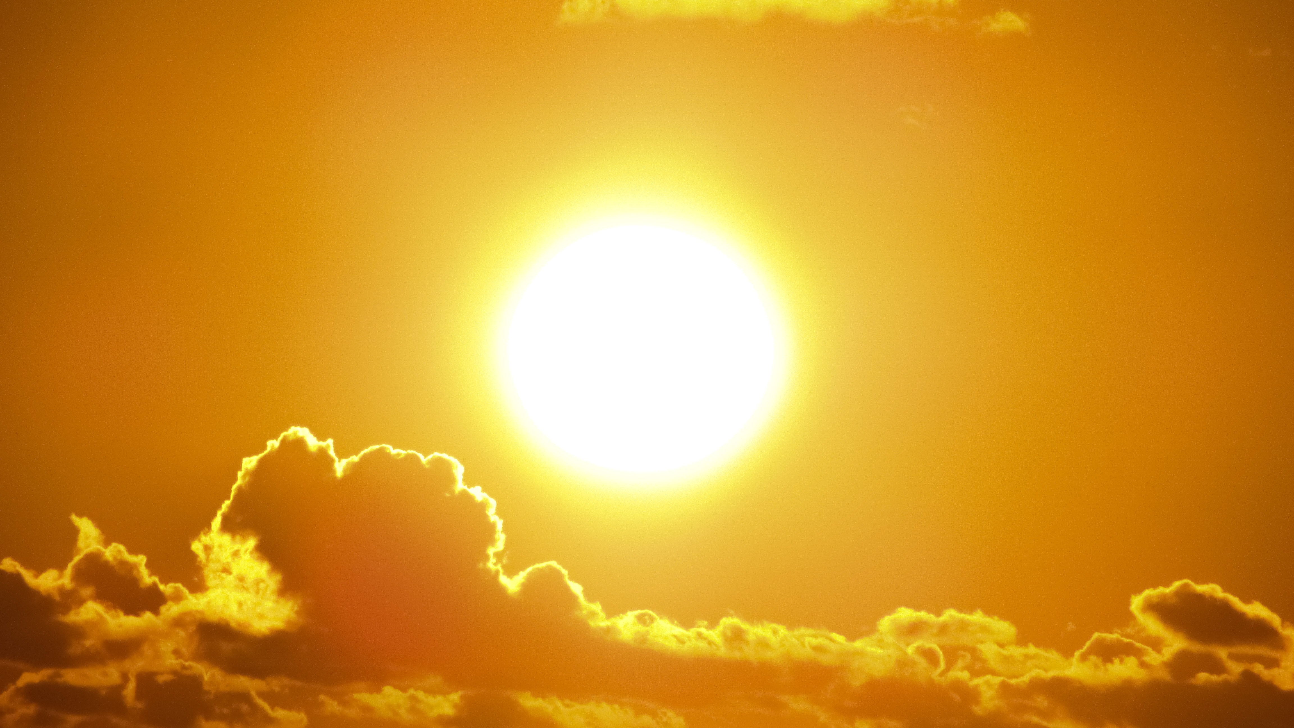
In our act of collective worship today, we are going to think a little more about the sun. There are many ideas on how the sun came to be – for instance, some think it is chance, others design.
Think/pair/share:
What facts do you know about the sun?
If you were going to describe the sun and what it does to someone who has never thought about it before, what would you tell them about it?

Slide 8
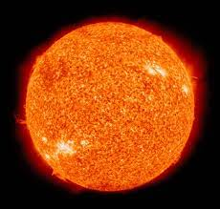
Here are some of my own sun facts. Did you know…?
The sun is a yellow dwarf star. At its hottest point, it reaches temperatures of 15,000,000°C.
https://commons.wikimedia.org/wiki/File:Sun-Moon_apparent_sizes_%28sequence%29.gif; Tdadamemd

Slide 9
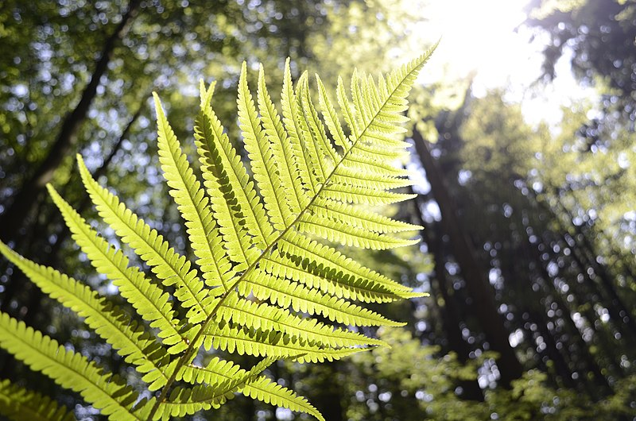
The sun’s heat and light are essential for life. In fact, the earth is just the right distance from the sun for life to thrive. Not too close (as it would be too hot) and not too cold for liquid water to exist. NASA call earth a planet in the ‘Goldilocks Zone’.
https://commons.wikimedia.org/wiki/File:Plant_growing_towards_the_sun.jpg; Sorrypoolsclosed

Slide 10
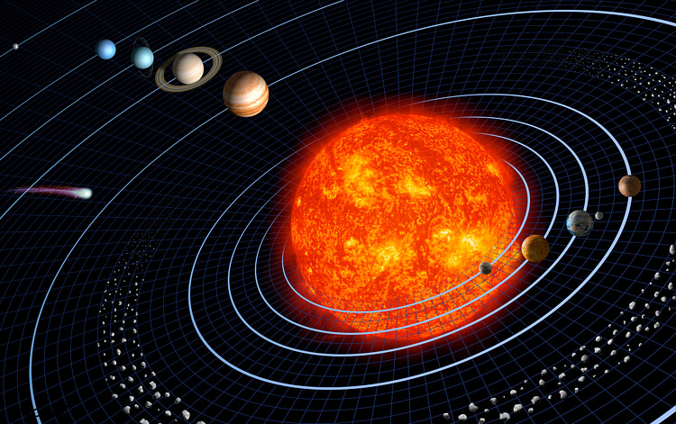
The sun is at the centre of our solar system. Planets, asteroids and comets in our solar system all orbit it.
https://www.flickr.com/photos/vintage_illustration/31411898307; Rawpixel

Slide 11
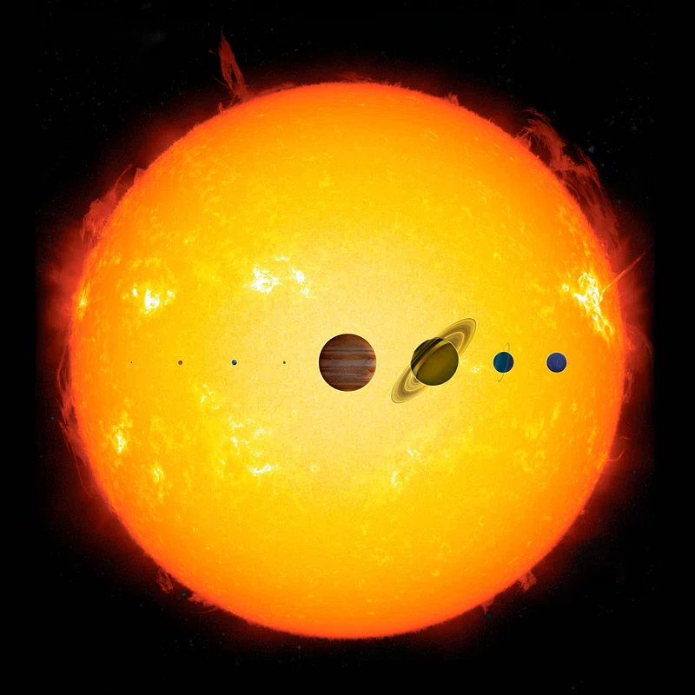
The sun is extremely large. It could contain roughly 1.3 million earths.

Slide 12

It takes eight minutes for light from the sun to reach Earth. With the sun 93 million miles away (on average), this means that light from the sun travels at a whopping 186,411 miles per second.

Slide 13
I wonder what fact you think is the most amazing?
I wonder if these facts have made you think of any other questions about the sun?
Take time to ponder these questions as you watch a time-lapse video of a sunrise (next slide); for many people, this (as well as a sunset) is one of the most beautiful things we can see in nature. (https://www.youtube.com/watch?v=o_kgdCGisso)

Slide 14
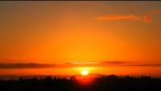

Slide 15
God
You created the world and sent your Son to live among us
made of the same stuff, breathing the same air, marvelling at the sunrise and sunset just as we do
God of love and life, teach us to love all that you have created and to care for the earth as your gift and our home
Amen

Slide 16
Why not take time, the next time it is sunny, just to rest, eyes closed, with the sun on your face.
Take this time just to think of how awesome and amazing the sun is, and how important it is for all life upon the earth.

