Slide 1

Collective Worship - ‘Day 4’, Plan 2

Slide 2

Recap
In our last Heart for the Earth collective worship, we thought about how amazing the sun is. Can anyone remember any of the facts we thought about?
We thought about how the light and heat from the sun is essential for all life on earth and how it takes just eight minutes for light from the sun to travel 93 million miles across space to reach us. We also thought about how the earth is just the right distance away from the sun for life to flourish; it is not too hot nor too cold.

Slide 3

Let’s think a little about what happens when the sun’s light reaches the earth.
When the sun’s rays reach the earth, they pass through a layer of gas that surrounds the Earth – the atmosphere.
The atmosphere contains lots of gases. These gases let the sunlight in (oxygen and nitrogen) and holds some of the warmth of the sun’s rays (carbon dioxide); this is called the greenhouse effect. Most of the sun’s heat is reflected back into space. Without these amazing gases, life on Earth would be very difficult (if not impossible!).

Slide 4
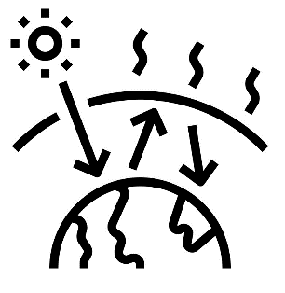
However, over the last two hundred years, the amount of carbon dioxide in the atmosphere is increasing due to human activity. This means that less heat from the sun is escaping into space; the Earth therefore gets warmer.
It’s a bit like a giant blanket or duvet. As humans have not been so careful in the way they live, work and treat the world, the ‘atmospheric duvet’ is getting thicker and keeping the heat in.
The average global temperature has increased by 1°C since 1880. The planet is getting warmer and warmer at a faster pace.

Slide 5





Scientists call the amount of carbon dioxide released into the atmosphere as a result of human activity our carbon footprint.
Here are some of the main contributors:
Food production Clothes production Fossil fuels Deforestation
I wonder…
Are there any facts here that surprise you?
Which do you think are easier for us to reduce our carbon footprint?
Which ones need other people to make the changes?
Which ones are a bit of both?

Slide 6
Planting more trees
Adopting a more planet friendly diet, such as eating less meat
Buying second-hand/pre-loved clothes and toys
Buying more locally grown food
The good news is that that so much is being done to help reduce carbon footprints. To prevent global temperature increase, many people are:
Switching to electric cars
Buying clothes made of more planet friendly materials such as linen or organic cotton (two of the least planet friendly materials are non-organic cotton and denim)
Looking after clothes and keeping for longer
Walking or cycling when able instead of using other means of transport

Slide 7
‘Every choice we make is a vote for a world we want to live in’
I invite you to think of your own ‘I wish’ and ‘I wonder’ on the subject of carbon footprints.
‘I wonder…’
‘I wish…’

Slide 8
God
I wonder…
I wish…
Amen

Slide 9
Together, we can all make a big difference.
I wonder how you and those you know might show a heart for the earth through reducing your carbon footprint?

