Slide 1

Add new branding
Week One, Plan One

Slide 2
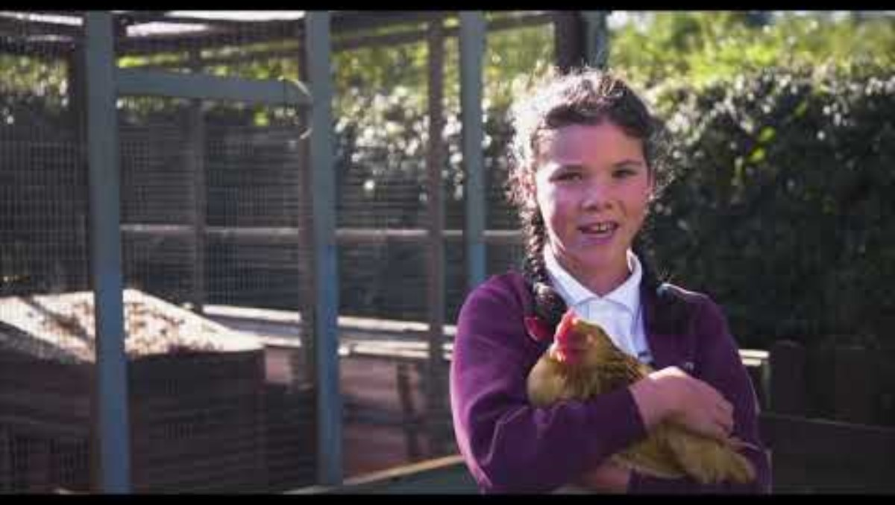

Slide 3
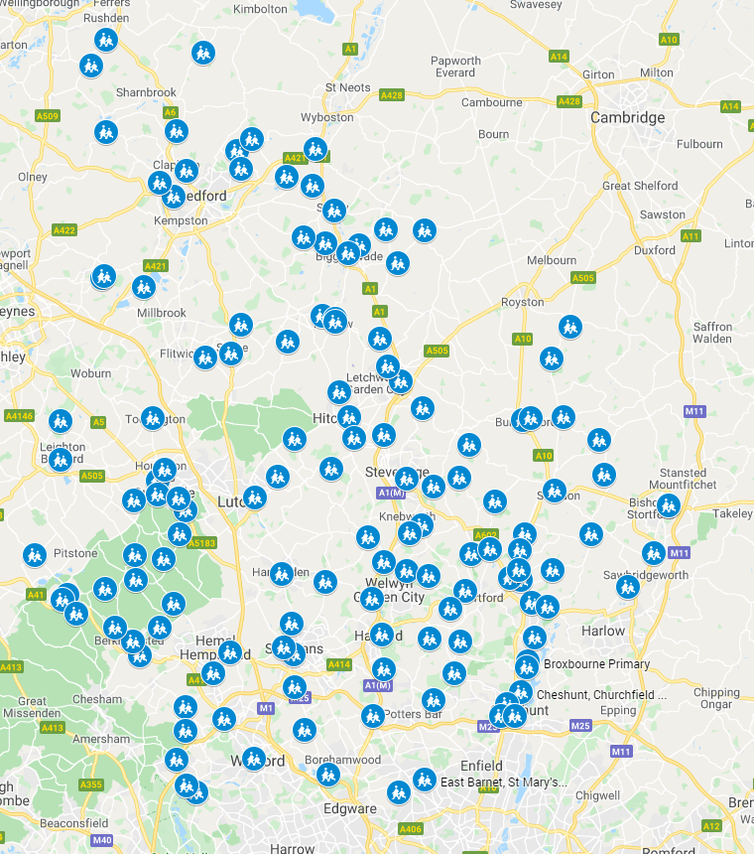

Slide 4


Jacob’s Ladder (Genesis 28: 10-22)

Slide 5


Slide 6


Slide 7


Slide 8


Slide 9


Slide 10
Our school vision
I wonder how God is with us in this place?

Slide 11
Prayer
Lord, we thank you that you are in this place.
In our relationships…
In our learning…
In our banter…
In our happy times…
In our lowest…
As we support each other…
Both in school…and out…
In who we aspire to be…
In what we aspire to do…
In what we aspire to change…
In our shared life together…
Helping each other to flourish…
We pray that over the next six weeks you can help us to learn more about ourselves and you as we explore the story of Jacob’s dream together.
We pray for other schools in our diocesan family also, that they may grow in understanding alongside us.
Amen.

Slide 12
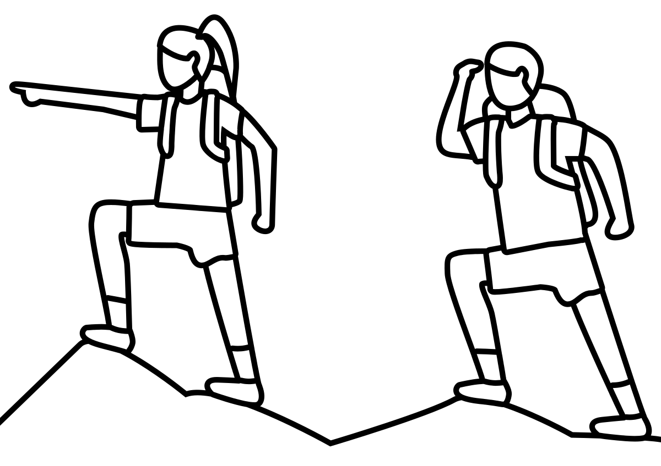
We are about to go on a spiritual journey.
How might you prepare?
How might you ready yourself for deep, spiritual reflection?

