Slide 1

Add new branding
Week One, Plan Three

Slide 2
Over the next few weeks, we are taking part in the ‘God in this place’ initiative. This is an opportunity, with other church schools in the Diocese of St Albans, to:
celebrate who we are as a Church of England school;
journey together as we explore the story of Jacob’s dream in Genesis 28; and
pray for our community as a Church of England school and our family of church schools in the Diocese.
It is important to think about ‘this place’. In a normal week, what are the different places that you go to? School, home, park, shops, anywhere else?

Slide 3

I wonder what you think of when you hear the word ‘community’?
We could think about the word community in two ways:
that we are part of different communities. School community, family community, village community, a sporting community, a community focussed around an interest or hobby etc.
the meaning of the word ‘community’. ‘Com-’ means ‘together’, and ‘munus’ means ‘gifts, time, treasure and talents’.

Slide 4

Inward
Outward

Slide 5
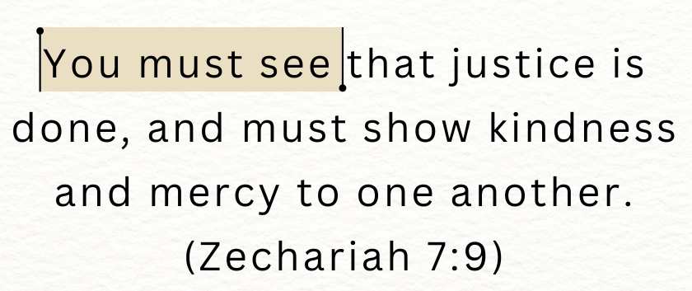

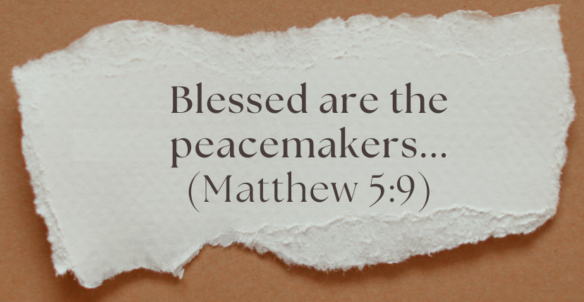

Slide 6
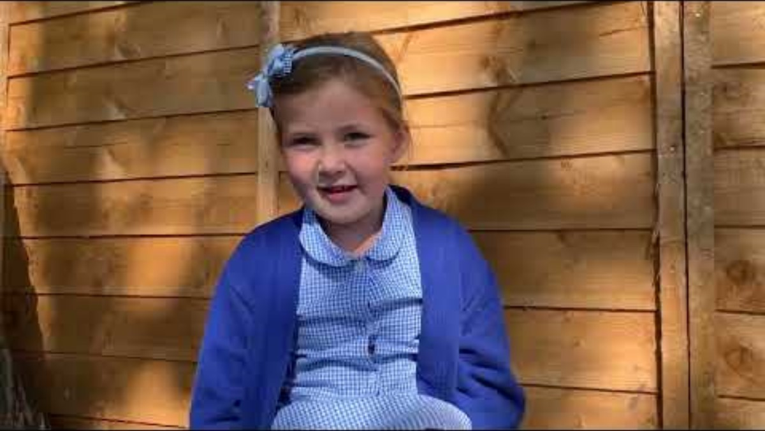
I wonder what you think are some of the biggest issues facing humanity/the world today? Let’s watch a video of a few people sharing their perspectives:

Slide 7
What do you think are the biggest issues facing the humanity/world today?
How can we help? What can we change?
What can we pray for?

Slide 8
As you go about your week, in all of the communities in which you are a part, I invite you to reflect upon ‘how God might be working in this place?’.
How might you join in?

