Slide 1

Week Two, Plan One

Slide 2


Slide 3
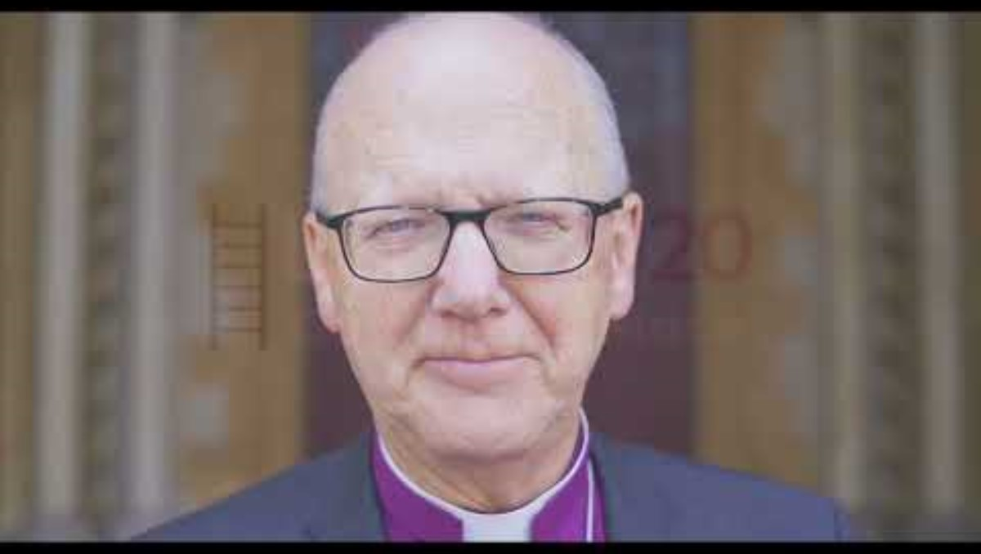

Slide 4
‘A journey where we’re going to discover new things together’.
Over the next five weeks, we will be exploring different themes in the story of Jacob’s Ladder in Genesis 28.
This week, we will think about the impact of a vision he had on his life’s journey.

Slide 5


Jacob’s Ladder (Genesis 28: 10-22)

Slide 6

Think about your journey through life so far. Like Jacob, you will have had experiences and encounters that have shaped you to be the person you are today. Perhaps these have been unexpected.
I wonder what those unexpected moments have been where you have discovered new things about life? Yourself? God?

Slide 7
Dear God,
We thank you for our journeys – as individuals and as a school.
As we leave this place, help us to discover new things about life, ourselves and you.
Amen.

Slide 8
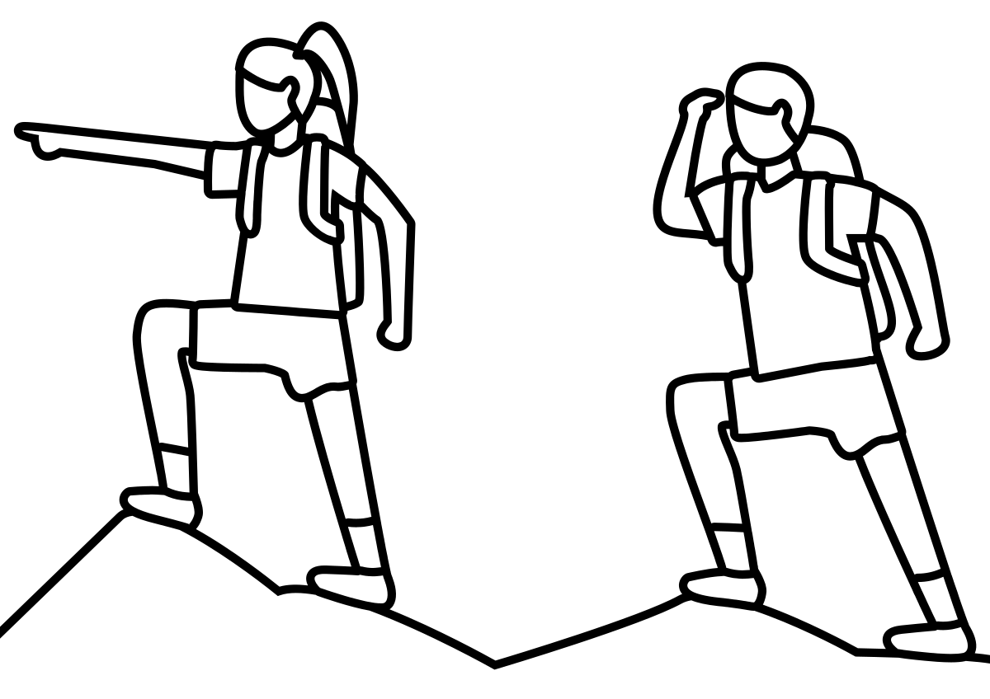
Continue thinking about your life journey so far.
What experiences and encounters have shaped you and your journey?

