Slide 1

Week Two, Plan Two

Slide 2


Slide 3
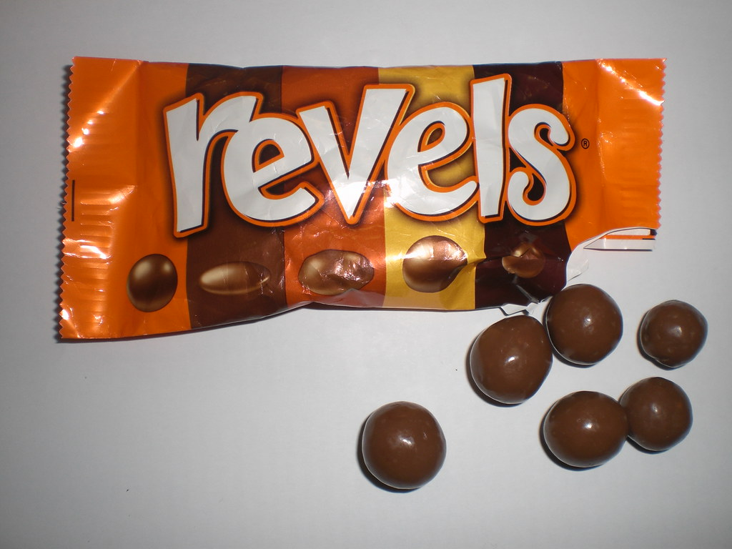
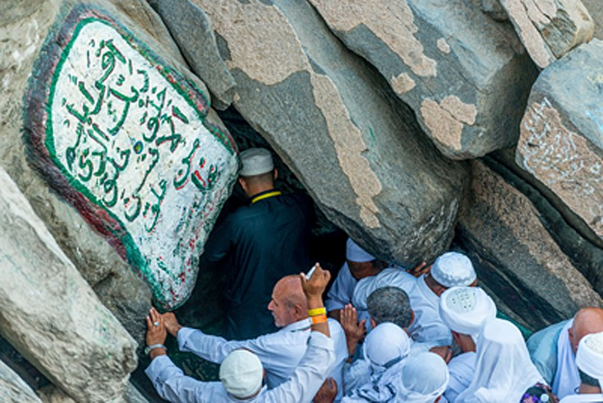
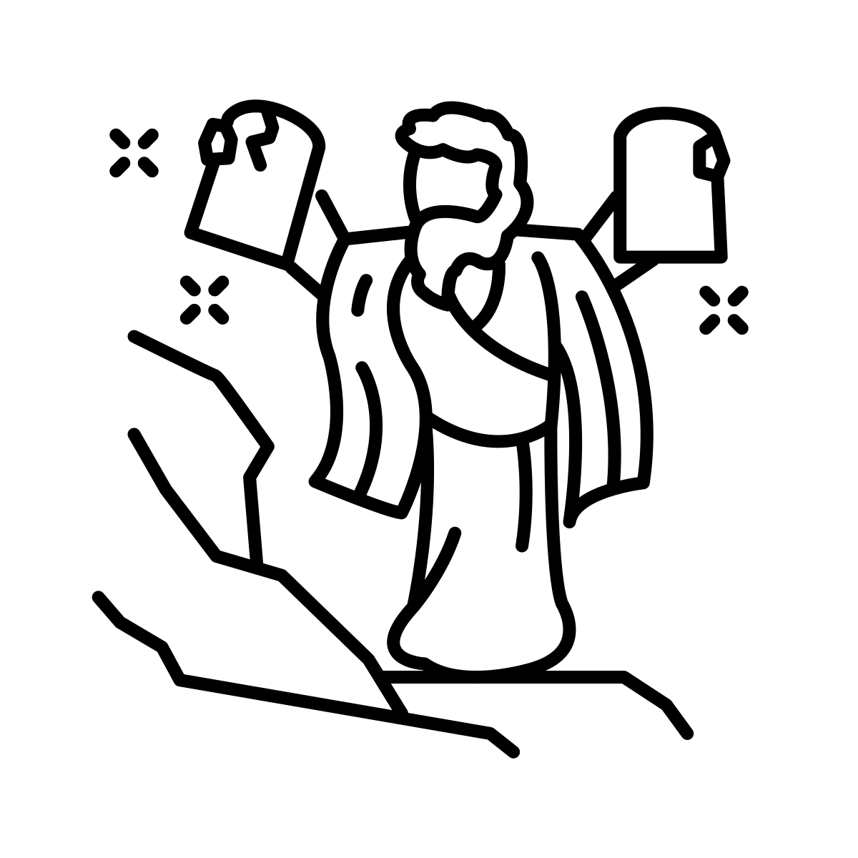
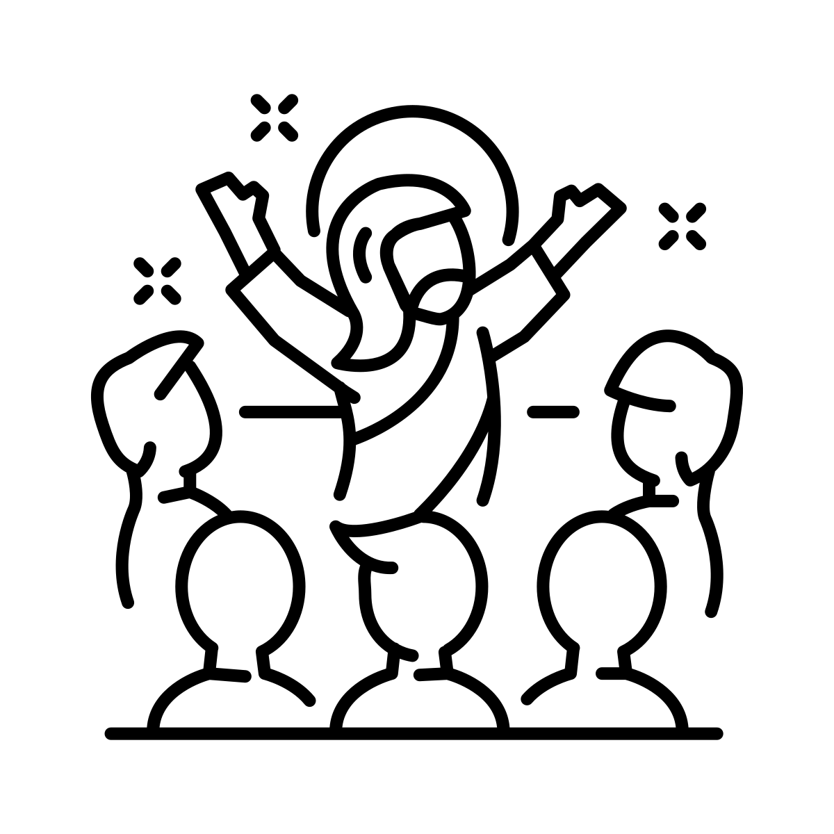
Saudipics: https://creativecommons.org/licenses/by-sa/4.0/deed.en

Slide 4
All of the previous four images link to ‘revelation’.
Dictionary definitions of revelation:
the divine or supernatural disclosure to humans of something relating to human existence
a surprising and previously unknown fact that has been disclosed to others

Slide 5
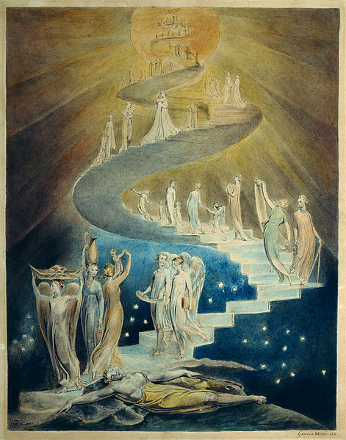
Jacob’s dream in Genesis 28 is a considered by many Christians to be a revelation from God.

Slide 6
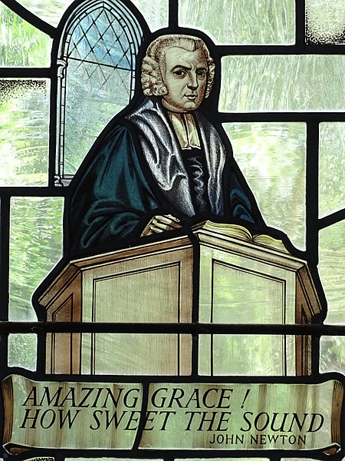
The writer John Newton (1725-1807) wrote about Jacob’s revelation in a poem.
John wrestled with his Christian faith for many years, before a storm at sea whilst he was in the navy reignited his faith.
Adam Jones; https://creativecommons.org/licenses/by-sa/2.0/deed.en

Slide 7
I wonder if we should be more open to listening to others telling us of extraordinary things that they have experienced in their life?
Or just be more open to our consciences telling us what is the right thing to do today?

Slide 8
Prayer
God of journeys, dreams and angels, be with us today.
As our day stretches out in front of us, like an open road, may we take advantage of all the opportunities that come our way.
As we think about our journeys, may we always be aware that you have spoken to many through dreams - and maybe our dreams are sometimes a word from you.

