Slide 1

Week Two, Plan Three

Slide 2



Jacob’s Ladder (Genesis 28: 10-22)

Slide 3
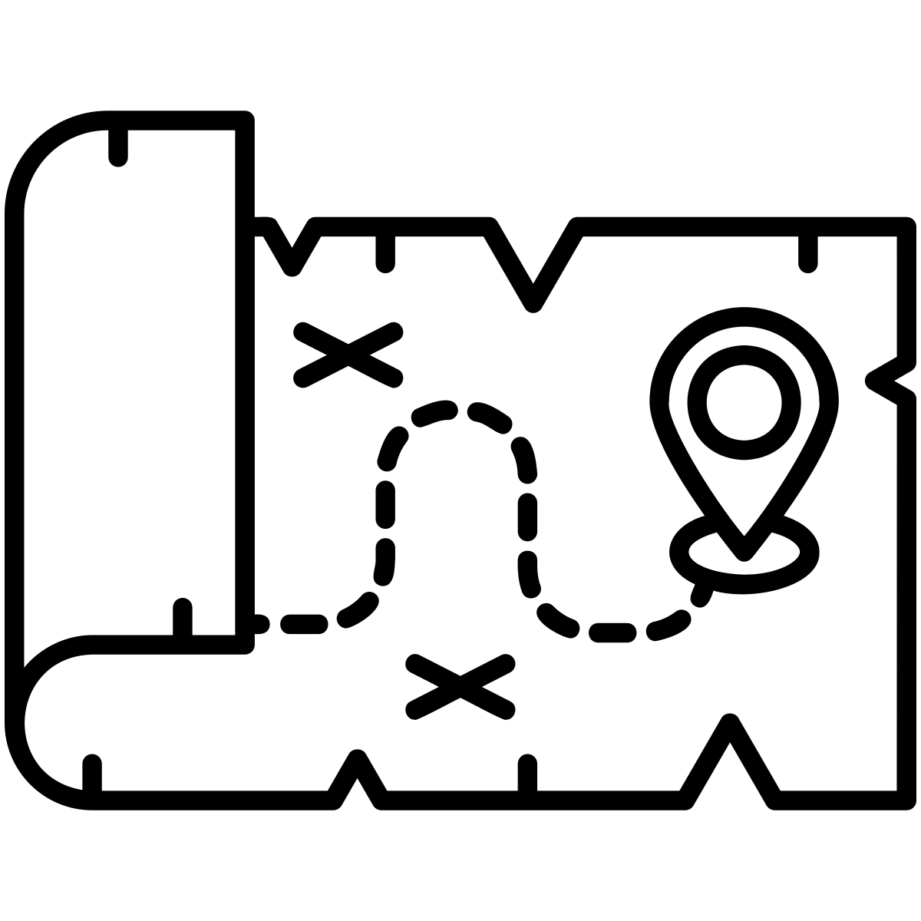
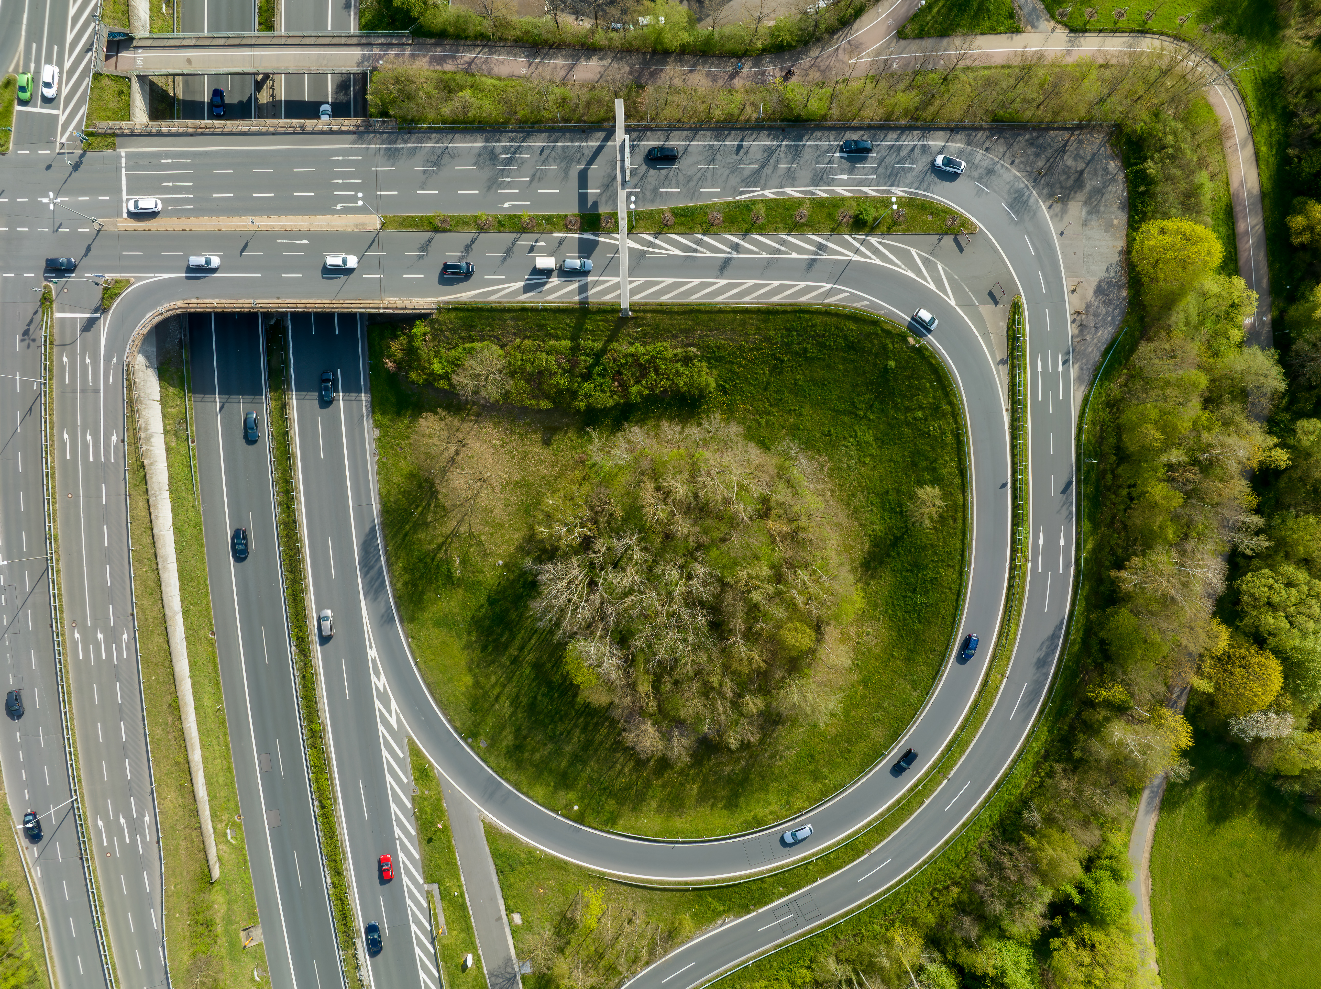
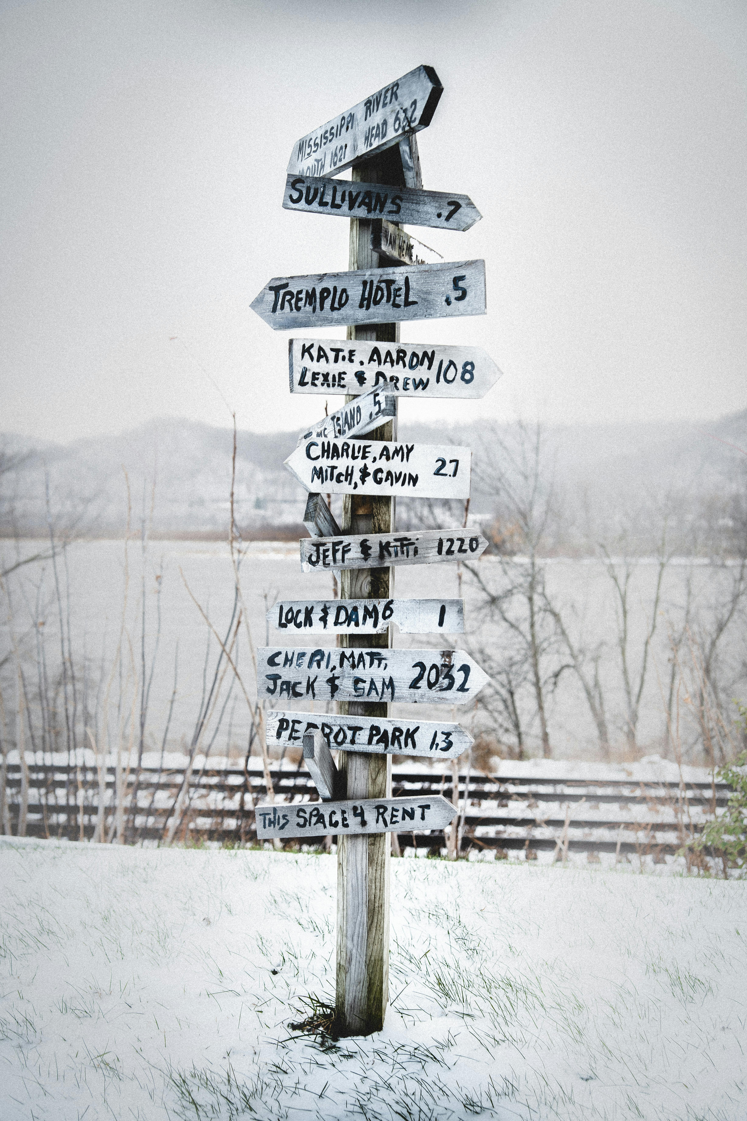
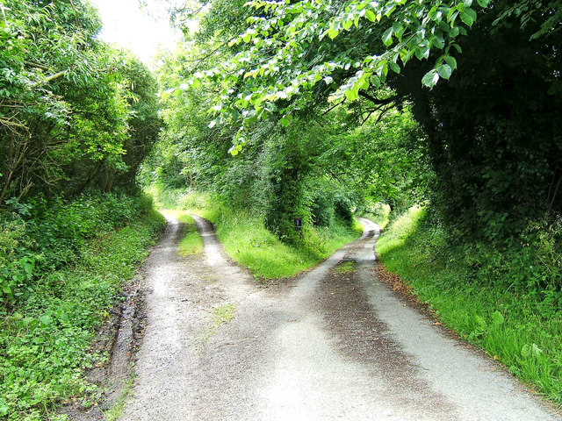
Reinhold Möller; https://creativecommons.org/licenses/by-sa/4.0/deed.en
P L Chadwick; https://creativecommons.org/licenses/by-sa/2.0/deed.en

Slide 4
Life is like a canvas. It begins blank and every day is another brush stroke.
Life is like a camera. Just focus on what’s important. Capture the good times. Develop from the negatives. And if things don’t work out, take another shot.
Life is like a coin. You can spend it any way you wish but you can only spend it once.
I wonder how often we stop to think about the journey of our life so far?
I wonder how often we pause to think about our future journeys – not just a ‘to do’ list, but a ‘to be’ list.

Slide 5
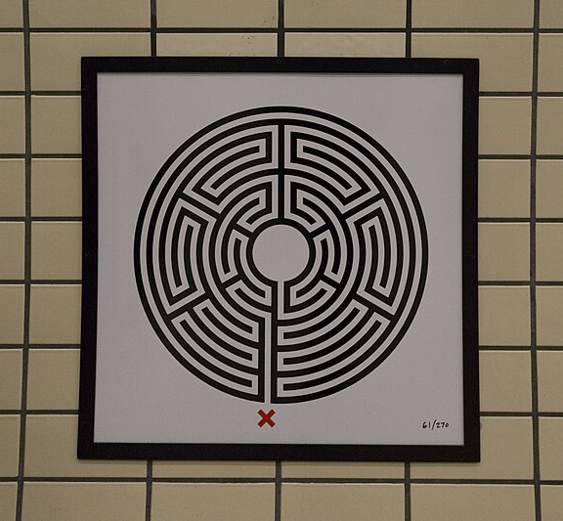
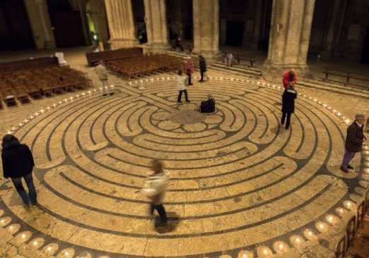
https://www.exeter-cathedral.org.uk/news-events/latest-news/the-labyrinth/
Jack Gordon; https://creativecommons.org/licenses/by-sa/4.0/deed.en

Slide 6

Labyrinths were (and are) used by Christian monks. They are walked slowly, offering a bounded space for personal reflection and spiritual pilgrimage.
Whereas a maze has a different entry and exit point, a labyrinth has the entry and exit point the same. A labyrinth is used as a space to exit the world, reflect on spiritual questions, and enter the world once again.

Slide 7
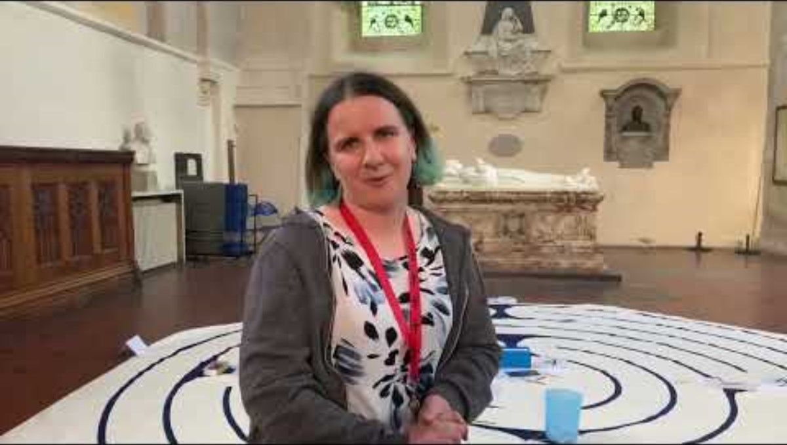

Slide 8
Jacob, in the Genesis text, stopped. Jacob rested. It was in this rest where he had his vision. Here he saw the bigger picture, discovering more about life, himself and God.
I wonder where you could set aside times to pause and reflect on your life’s journey?
I wonder what would be on your ‘to do’ list? Your ‘to be’ list?
What goals could you set to be the kind of person you want to be? What choices could you make today, to help your lists become a reality?

