Slide 1

Week Two, Plan Three

Slide 2



Jacob’s Ladder (Genesis 28: 10-22)

Slide 3
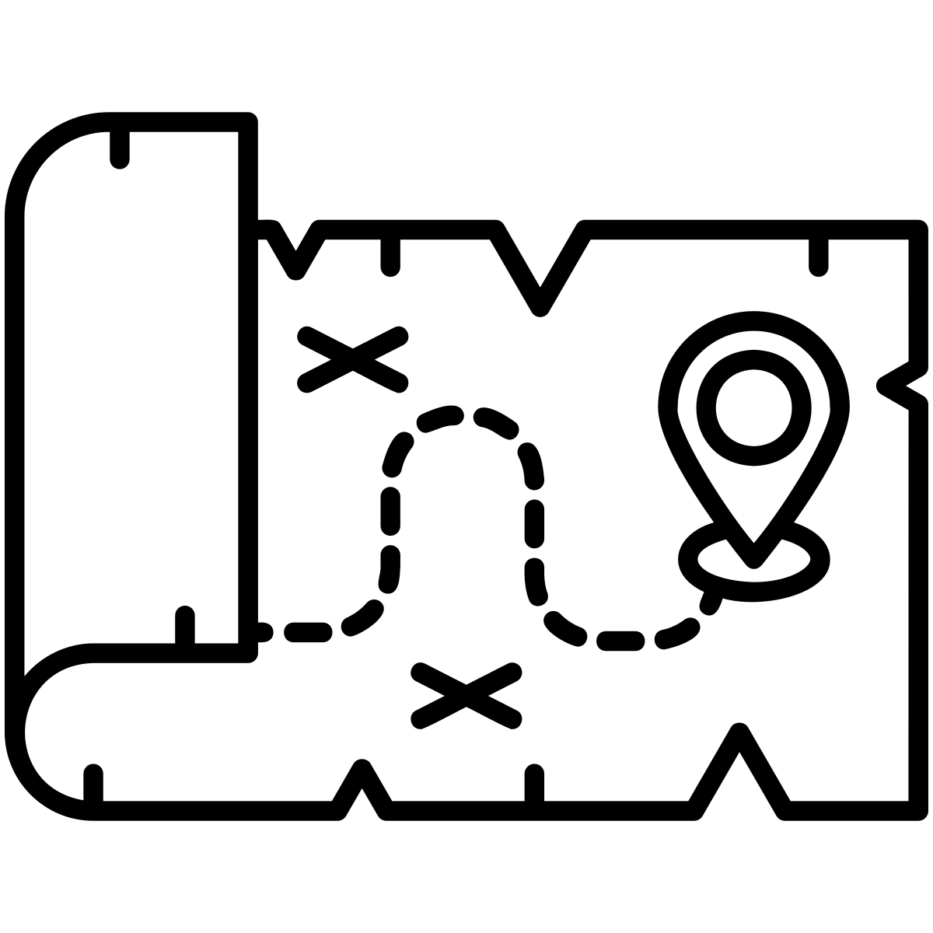
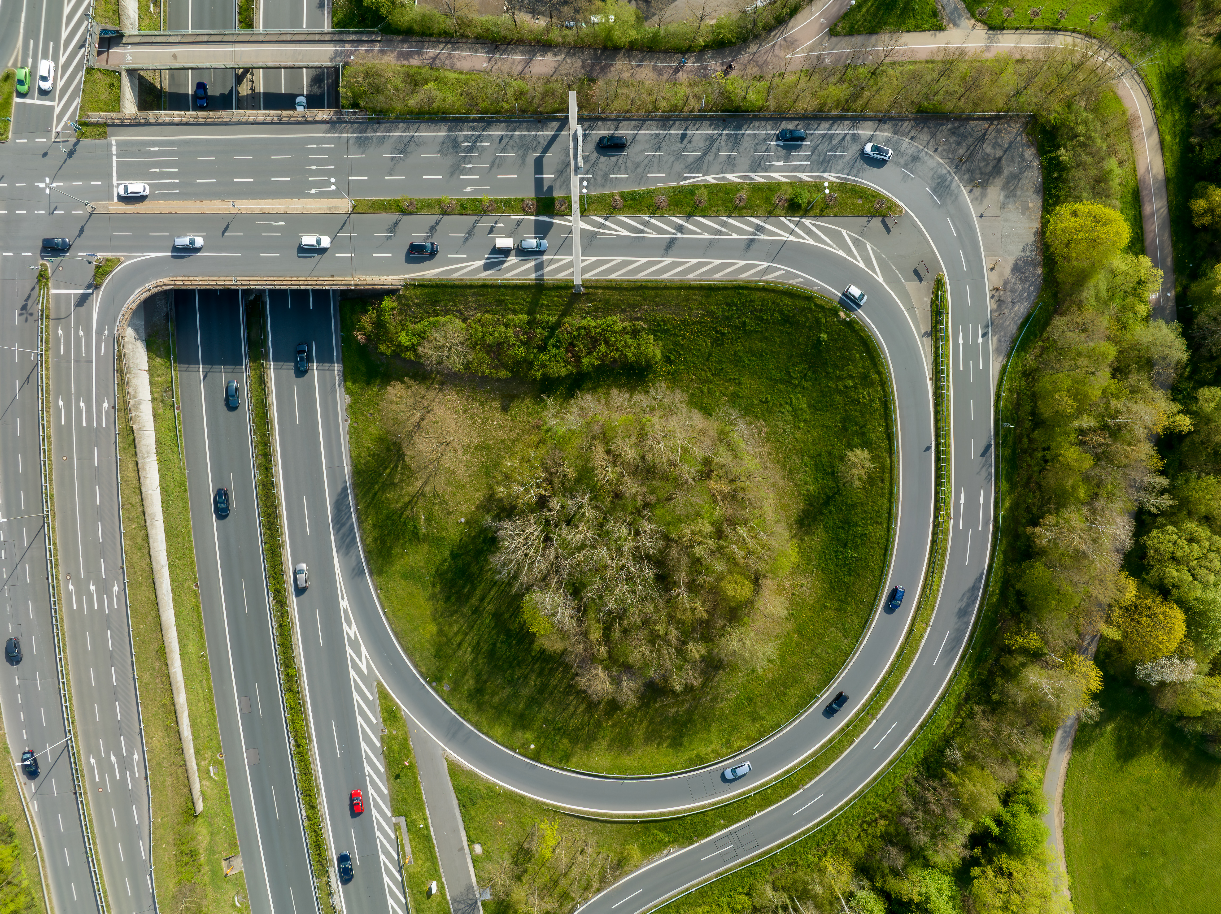
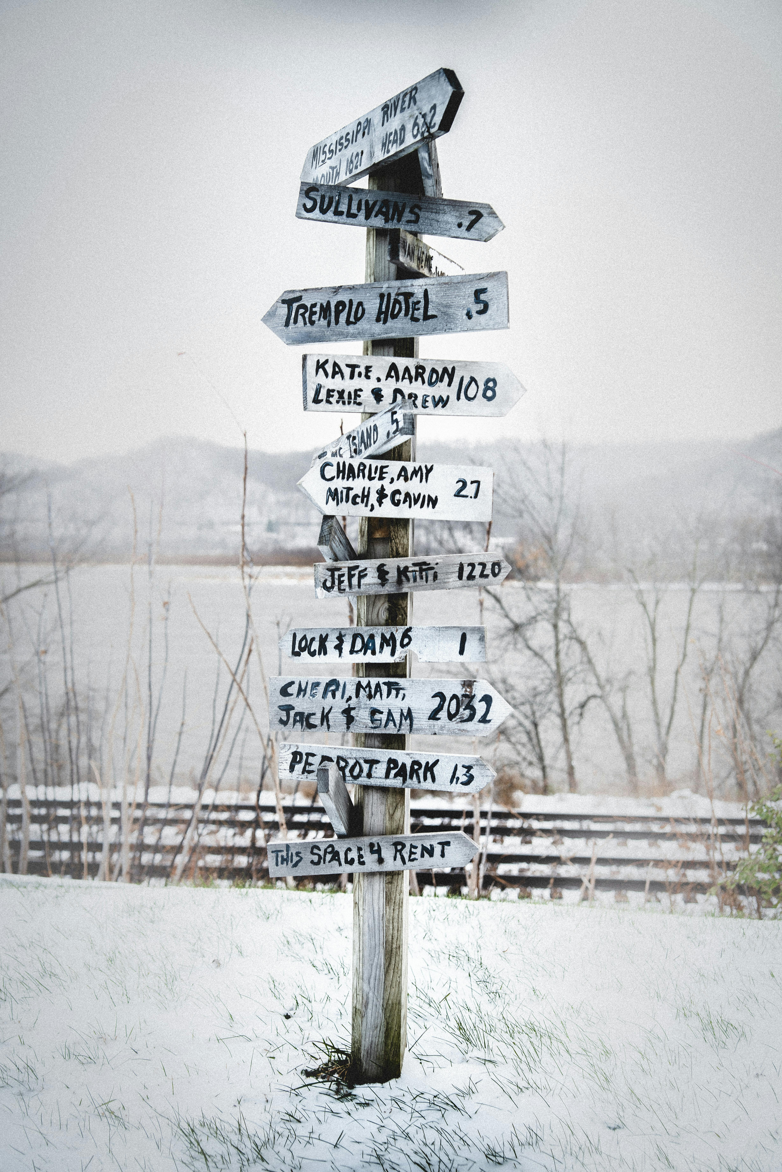
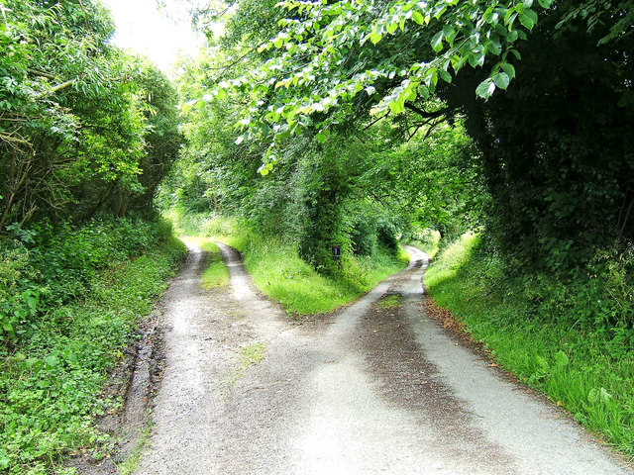
Reinhold Möller; https://creativecommons.org/licenses/by-sa/4.0/deed.en
P L Chadwick; https://creativecommons.org/licenses/by-sa/2.0/deed.en

Slide 4
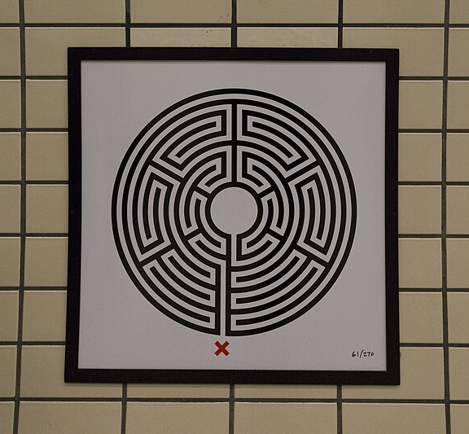
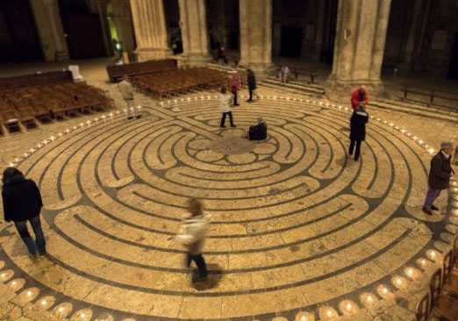
https://www.exeter-cathedral.org.uk/news-events/latest-news/the-labyrinth/
Jack Gordon; https://creativecommons.org/licenses/by-sa/4.0/deed.en

Slide 5
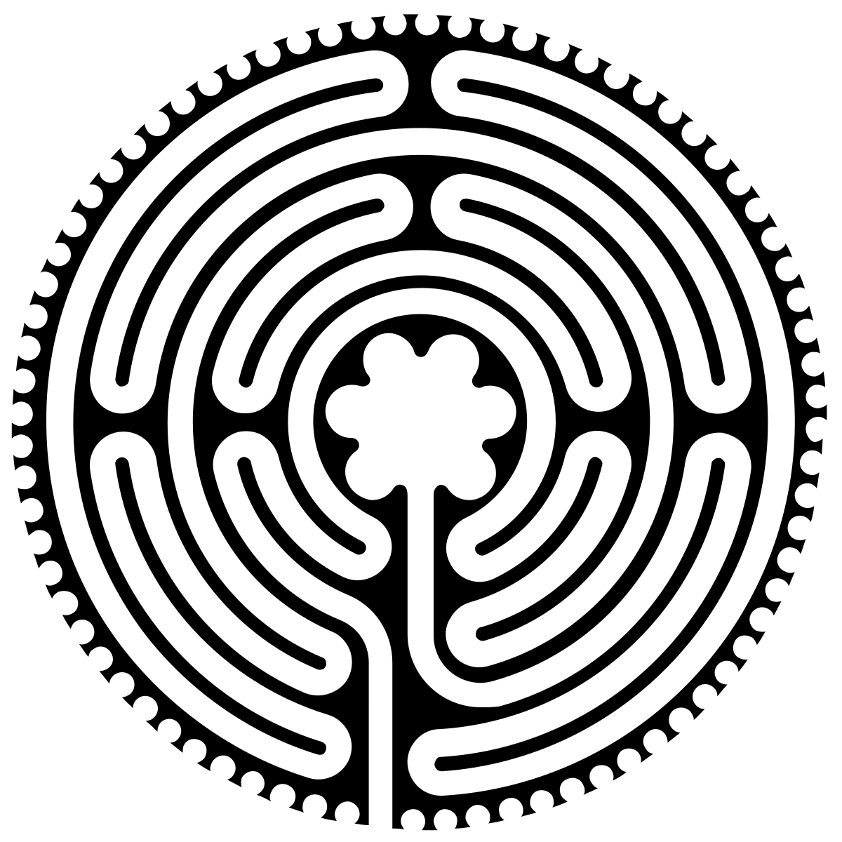
Labyrinths were (and are) used by Christian monks. They are walked slowly, offering a bounded space for personal reflection and spiritual pilgrimage.
Whereas a maze has a different entry and exit point, a labyrinth has the entry and exit point the same. A labyrinth is used as a space to exit the world, reflect on spiritual questions, and enter the world once again.

Slide 6
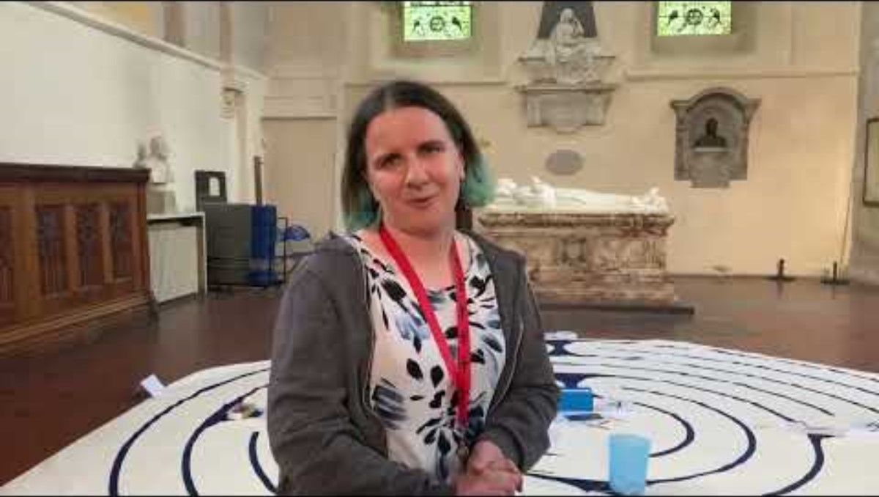

Slide 7
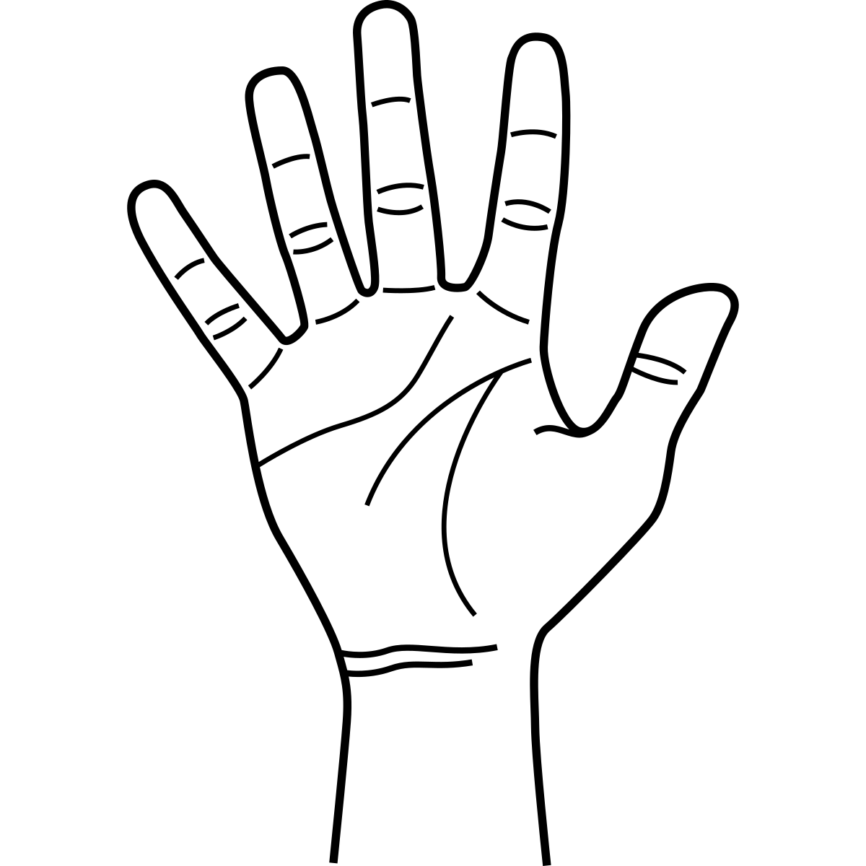
‘Palm line’ reflection
Look at your open palms and your ‘palm lines’. Everybody’s palm lines are different – no two are the same! Take a moment to think about how unique you are.
Next, slowly trace along the palm lines on your hand using your index finger on the other.
Whenever you reach a point where your palm line changes direction, or you move to another ‘line’, consider what makes you unique, special, and different from anyone else.
We are now going to repeat this. This time, where you meet a change of direction or ‘line’, consider a positive choice or action you could make today to help somebody else in their life journey.

Slide 8
You show me the path of life.
In your presence there is fullness of joy. (Psalm 16:11)
I wonder how this verse makes you feel?

Slide 9
Prayer
Jacob went on a journey through life. It was when Jacob stopped and rested, that he had his vision. In this rest in the ‘busy-ness’ of life, he discovered more about himself, life and God.
Lord, as we leave this place, help us to find time to rest and think about our life’s journeys. Show us the path of life, and help us to support others as we journey together.
Amen

