Slide 1
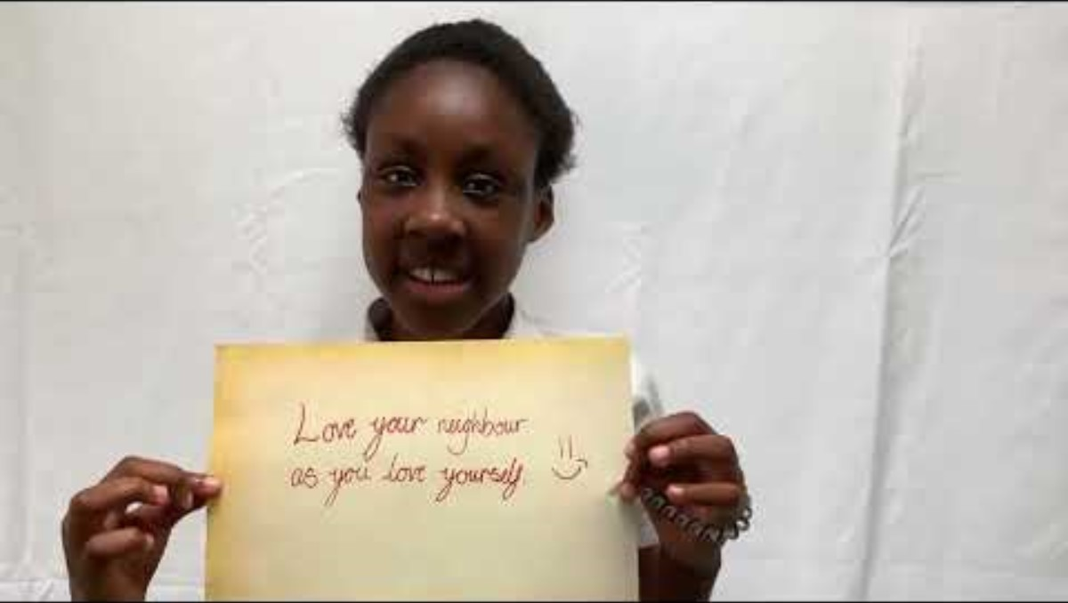

Slide 2

Week Three, Plan One

Slide 3



Jacob’s Ladder (Genesis 28: 10-22)

Slide 4


Slide 5

I wonder…how many of us have had a dream that has stayed with us? A dream that has meant a lot to us?

Slide 6
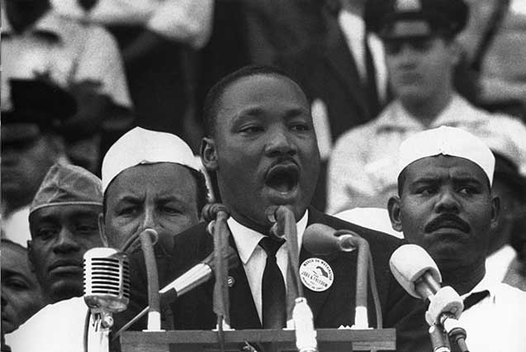
People talk about dreams a lot – a dream house, a dream holiday, a dream job. Often people are told to ‘follow their dreams’.
Some talk about dreams as a vision. A vision for a better future, a better world.
These dreams are often linked to hope. Martin Luther King had a famous dream like this. His dream was to live in a world where everybody was treated equally.
CC BY 2.0 – David Erickson

Slide 7
‘I dream to live in a world where…’
How might you complete this sentence starter today?

Slide 8
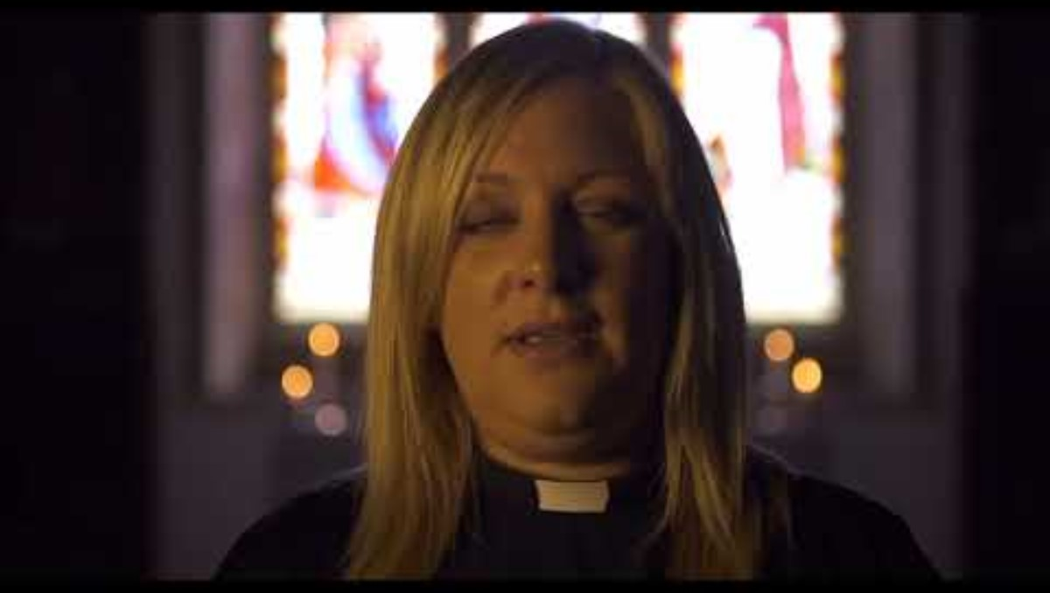

Slide 9
In the VLOG, Kim mentioned how Jacob had received from God in his dream ‘promise for the present and hope for the future’.
Let’s take a moment of reflection:
I wonder what your dreams for the future are? A vision for a better future…
…for you?
…for us as a school community?
…for the world?
I wonder where this vision has come from? Yourself? God?

Slide 10
God,
We have thought today about Jacob’s amazing dream where you offered him ‘promise for the present and hope for the future’.
We pray that you can be with us now, in this place, as we seek to know you and your plans for us.
Amen

