Slide 1
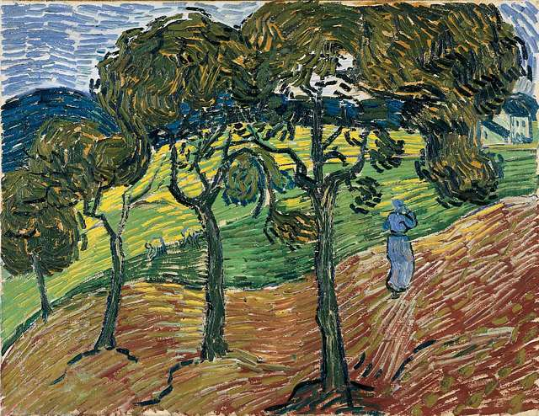

Slide 2

Week Three, Plan Two

Slide 3


Slide 4


Slide 5
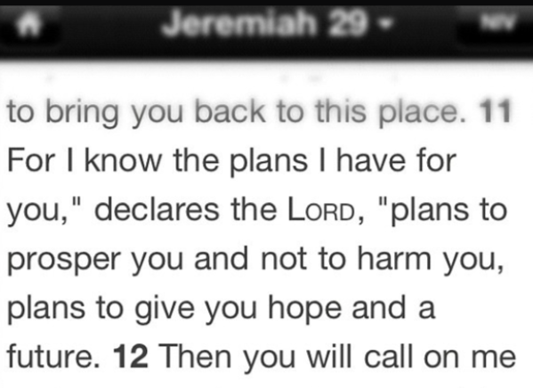
CC BY-NC 2.0 Diane Main

Slide 6
Time to Talk – chat to the person next to you, what were the hopes and dreams you silently reflected on at the beginning? Share some of them together.
Time to Think – take a moment of quiet reflection, think about how your journey towards your dream may be different to what you imagine, ponder on challenges you may have to overcome. How might God help you on that journey?

Slide 7
Time to Pray – Use a prayer that is simple and perfect for the journey of life. Prayer is as Easy as 1, 2, 3:
Minute 1 – Think about the high point of the day/week, something really good and give God thanks.
Minute 2 – Think about a low point of the day/week, something bad that made you feel sad or worried. Ask God for help or forgiveness.
Minute 3 – Think about the future, tomorrow, next week or your dreams you’ve been reflecting on today. Ask God for special guidance on your journey.

Slide 8
CC BY-NC 2.0 Diane Main

