Slide 1
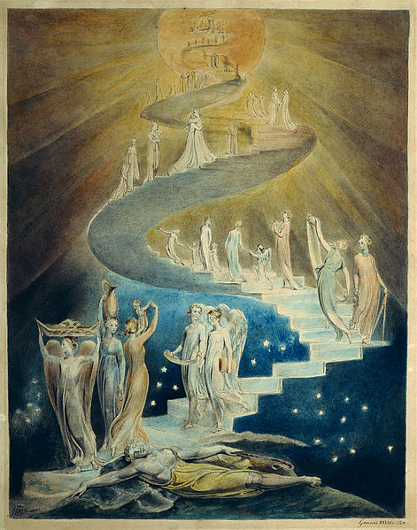

Slide 2

Week Three, Plan Three

Slide 3


Slide 4


Jacob’s Ladder (Genesis 28: 10-22)

Slide 5
Discuss with those next to you:
How was Jacob feeling before he settled down to sleep?
How do you think he is feeling after his dream?
Reflect on Jacob’s journey, and that God is with him, guiding him.
Let’s hear some thoughts!
Extension option: Can you think of encouraging messages for each other to add around the outside of the ladder?

Slide 6
‘When I’m afraid I put my trust in you’
Psalm 56:3

Slide 7
How often do you take time to stop and be still and think about your hopes and dreams?
How will you keep going and looking forward when your dreams seem impossible?

Slide 8
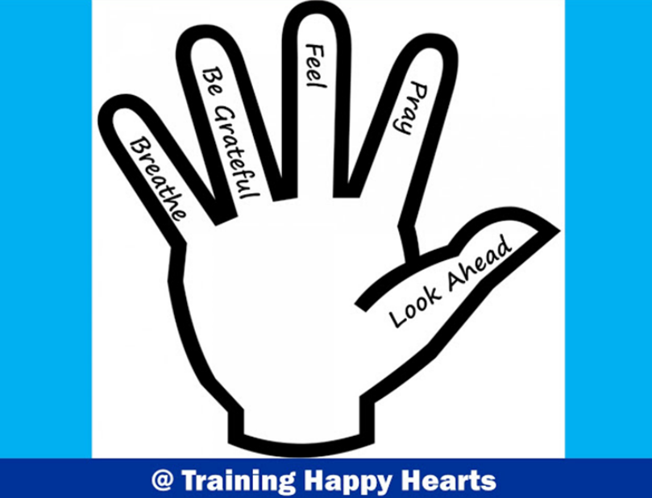

Slide 9
‘When I’m afraid I put my trust in you’
Psalm 56:3

