Slide 1

Week Four, Plan One

Slide 2


Jacob’s Ladder (Genesis 28: 10-22)

Slide 3


Slide 4


Slide 5


Slide 6
I wonder what the most amazing thing you’ve ever been told is?
I wonder what the most encouraging words you have ever heard have been?

Slide 7
Be the change you want to see in the world. (Gandhi)
We are like broken pots – it is when we are broken our light shines brightest.
Carpe Diem – seize the day!

Slide 8
For Jacob, during his journey and dream, he had some himself some encouraging words and promises from God.
I will give your descendants this land, and they will spread north, south, east and west;
All peoples on earth will be blessed through you and your children;
I am with you and will watch over you wherever you go; and,
I will not leave you until I have done what I have promised you.

Slide 9
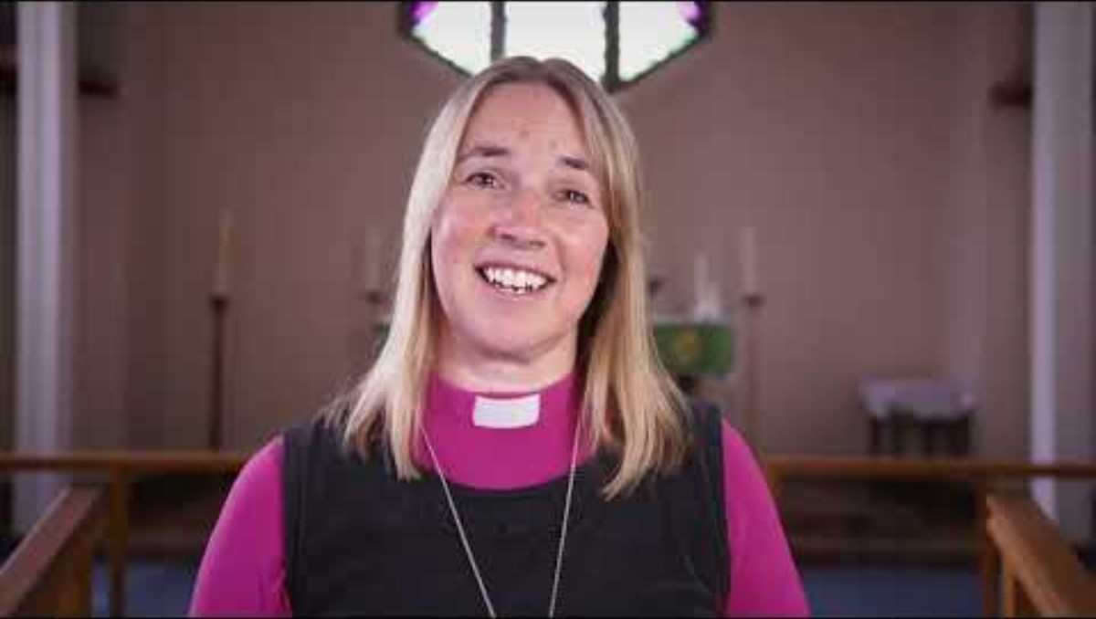

Slide 10

‘I am with you and will watch over you wherever you go’ (Genesis 28: 15).

Slide 11
‘I am with you and will watch over you wherever you go’ (Genesis 28: 15).
Why do you think Jacob was encouraged by this promise?
What promises do you base your life on? What or whose words encourage you?

Slide 12
Prayer
God
We thank you for the promises and words of encouragement you gave Jacob
We thank you for your promises to us today
That you will be with us and watch over us wherever we go
May we be mindful that you are with us in this place
Amen

