Slide 1

Week Four, Plan Two

Slide 2


Slide 3
When is a promise a promise?

Slide 4
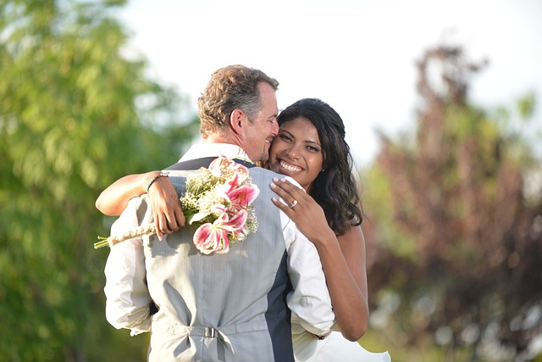
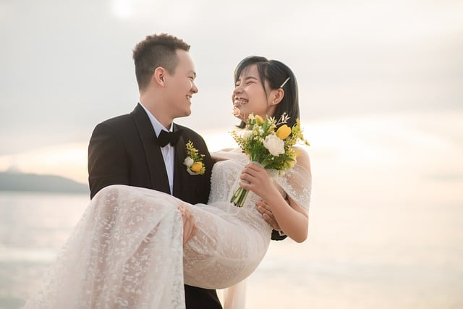
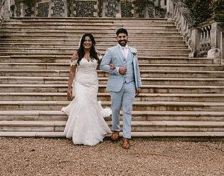
A promise is a promise when the words of the promise have love behind them. For instance, getting married is all about promise; it is one of the deepest promises two human beings can make to each other. It is a promise of love.

Slide 5

What do you think are the most important promises people make when they get married?

Slide 6
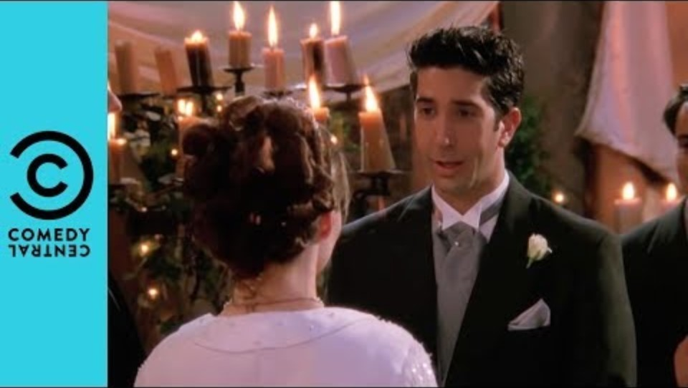

Slide 7
I, N, take you, N,
to be my wife,
to have and to hold
from this day forward;
for better, for worse,
for richer, for poorer,
in sickness and in health,
to love and to cherish,
till death us do part;
according to God’s holy law.
In the presence of God I make this vow.
I, N, take you, N,
to be my husband,
to have and to hold
from this day forward;
for better, for worse,
for richer, for poorer,
in sickness and in health,
to love and to cherish,
till death us do part;
according to God’s holy law.
In the presence of God I make this vow.

Slide 8

We know the actors saying these words have not actually gotten married through saying them. They were not real promises.
It is the love that two people have for each other that helps them make and keep deep promises to each other.
+
= promise lived

Slide 9

Why do you think marriage promises sometimes break down?

Slide 10
I, N, take you, N,
to be my wife,
to have and to hold
from this day forward;
for better, for worse,
for richer, for poorer,
in sickness and in health,
to love and to cherish,
till death us do part;
according to God’s holy law.
In the presence of God I make this vow.
I, N, take you, N,
to be my husband,
to have and to hold
from this day forward;
for better, for worse,
for richer, for poorer,
in sickness and in health,
to love and to cherish,
till death us do part;
according to God’s holy law.
In the presence of God I make this vow.
God’s name is there in the Vows because God is all about perfect love.

Slide 11
'God is love' (1 John 4:16)
'There is no fear in love, but perfect love casts out all fear' (1 John 4:18)

Slide 12
Do you think it is easier to keep a promise if someone else can share in helping keep that promise?
Have you ever helped someone keep their promise?
God can help people keep their marriage promises because He knows all about love and how tough love sometimes can be, because He is love. The Marriage Vows are a kind of prayer – asking for God’s help, support and love.

Slide 13

We can ask God for help to keep our promises, even promises we have made to him. Remember a promise only really lives if there is love behind it; love for a friend, for family, or for God. But God can help us with the love that we need behind any promise that is really deep and meaningful.
Are there any promises we have made which we need God’s help to keep? If you’d like to, take a moment now to prayerfully commit your thoughts to God.

