Slide 1

Week Four, Plan Two

Slide 2


Slide 3
When is a promise a promise?

Slide 4
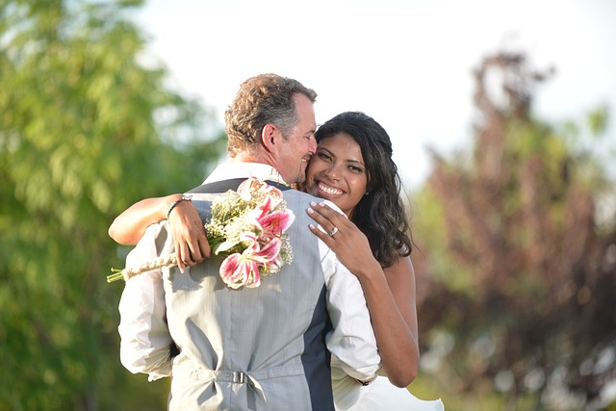
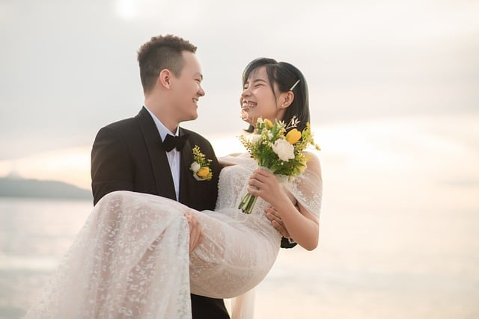
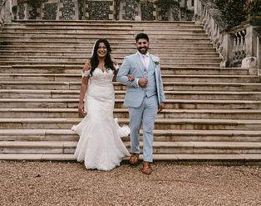
A promise is a promise when the words of the promise have love behind them. For instance, getting married is all about promise; it is one of the deepest promises two human beings can make to each other. It is a promise of love.

Slide 5

What do you think people promise when they get married?

Slide 6
I, N, take you, N,
to be my wife,
to have and to hold
from this day forward;
for better, for worse,
for richer, for poorer,
in sickness and in health,
to love and to cherish,
till death us do part;
according to God’s holy law.
In the presence of God I make this vow.
I, N, take you, N,
to be my husband,
to have and to hold
from this day forward;
for better, for worse,
for richer, for poorer,
in sickness and in health,
to love and to cherish,
till death us do part;
according to God’s holy law.
In the presence of God I make this vow.
Now we have acted out the Vows, what do you think these vows are promising?

Slide 7

Why are the vows that we have just acted out not real promises?
It is the love that two people have for each other that helps them keep their deep promises to each other.
+
= promise lived

Slide 8

Why do you think marriage promises sometimes break down?

Slide 9
I, N, take you, N,
to be my wife,
to have and to hold
from this day forward;
for better, for worse,
for richer, for poorer,
in sickness and in health,
to love and to cherish,
till death us do part;
according to God’s holy law.
In the presence of God I make this vow.
I, N, take you, N,
to be my husband,
to have and to hold
from this day forward;
for better, for worse,
for richer, for poorer,
in sickness and in health,
to love and to cherish,
till death us do part;
according to God’s holy law.
In the presence of God I make this vow.
Did anyone spot God’s name in the Marriage Vows?
God’s name is there in the Vows because God is all about perfect love.

Slide 10
'God is love' (1 John 4:16)
'There is no fear in love, but perfect love casts out all fear' (1 John 4:18)

Slide 11
Do you think it is easier to keep a promise if someone else can share in helping keep that promise?
Have you ever helped someone keep their promise?
God can help people keep their marriage promises because He knows all about love and how tough love sometimes can be, because He is love. The Marriage Vows promises are rather like a prayer because prayer is how we talk to God and ask him for help.

Slide 12

We can ask God for help to keep our promises, even promises we have made to him. Remember a promise only really lives if there is love behind it; love for a friend, for family, or for God. But God can help us with the love that we need behind any promise that is really deep and meaningful.
Are there any promises we have made which we need God’s help to keep? Let’s use our ideas to make a prayer.

