Slide 1

Week Four, Plan Three

Slide 2


Slide 3
When is a promise real?
Has anyone ever made a New Year’s Resolution?

Slide 4
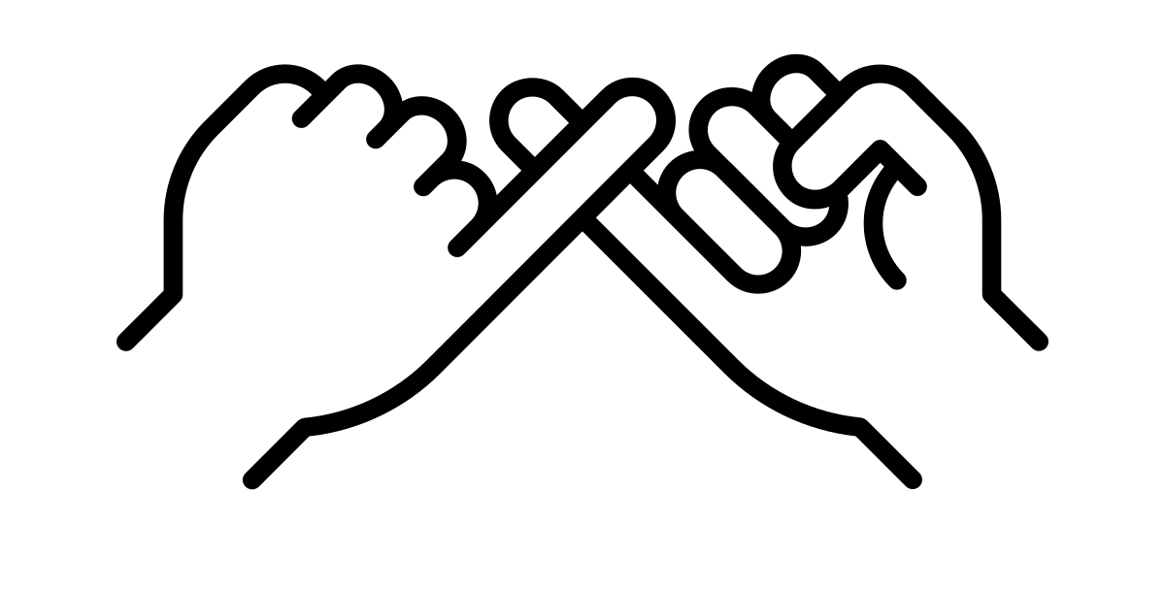
Has anyone ever broken a promise to you?

Slide 5
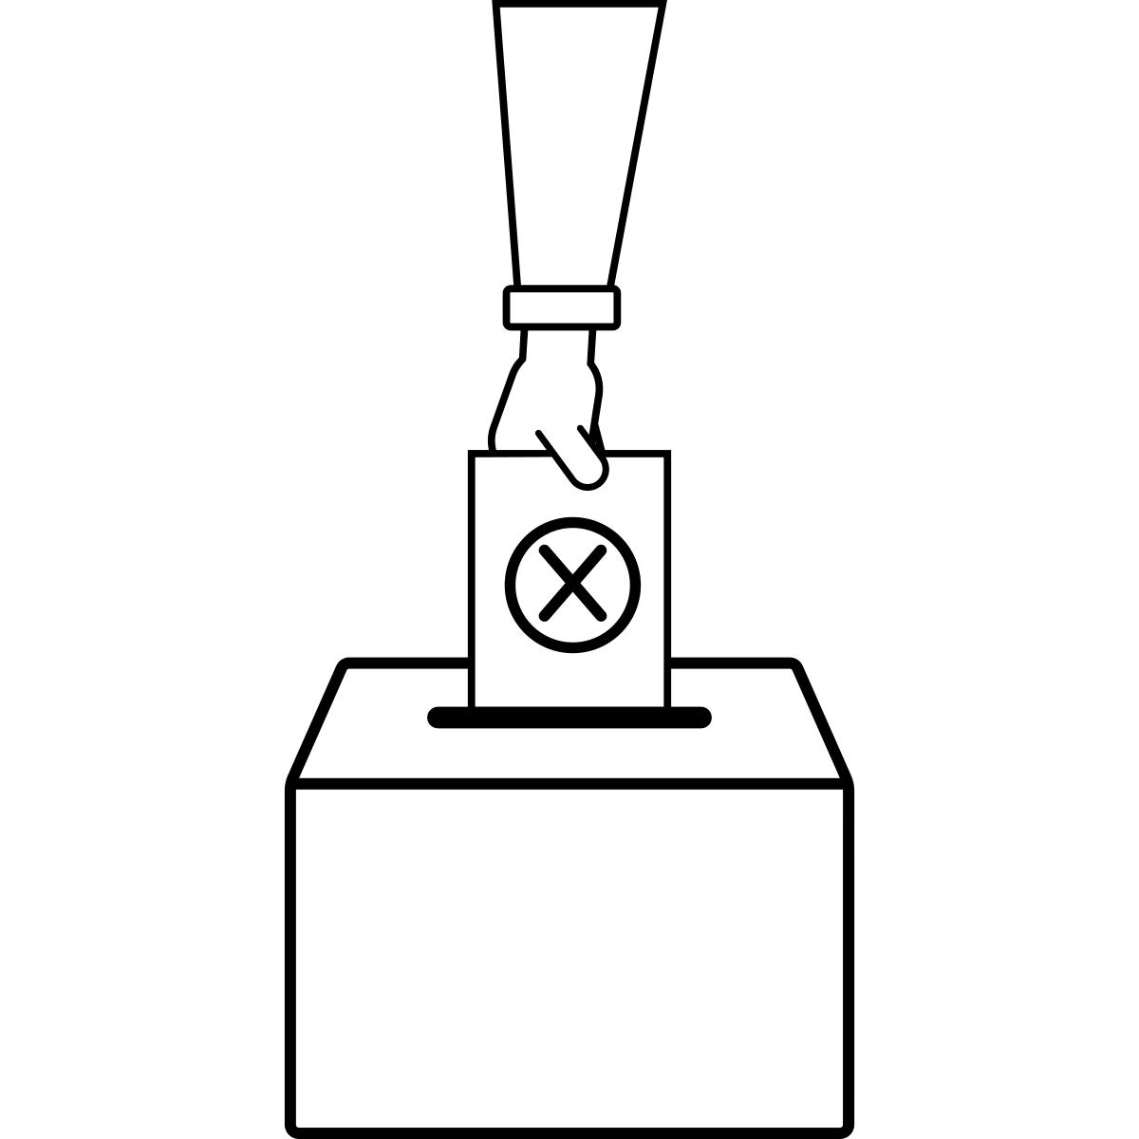
What do you think is important to making a promise real?

Slide 6
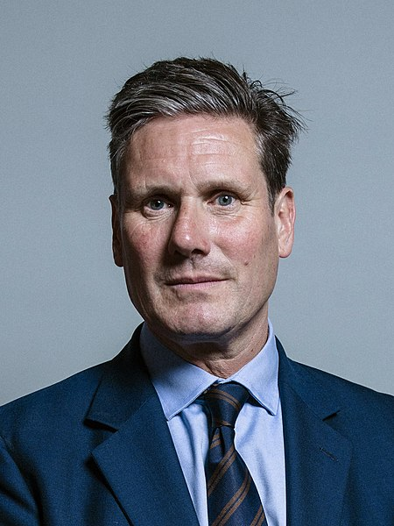
CC BY 3.0 – Chris McAndrew
https://www.bbc.co.uk/news/videos/czrj3zd0g48o

Slide 7
What do you think might happen if politicians do not keep their promises?

Slide 8
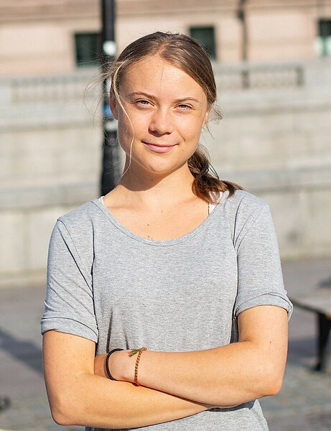
CC BY-SA 4.0 – Kushal Das

Slide 9

TRUST is important in making a promise real. You need to be able to TRUST people who make promises.
Of the people you know, who do you TRUST to keep a promise they make to you?
Why do we TRUST these people?

Slide 10


Christians believe that God has made us lots of promises, just like He made big promises to Jacob. We explored the promises to Jacob a few days ago:
I will give your descendants this land, and they will spread north, south, east and west;
All peoples on earth will be blessed through you and your children;
I am with you and will watch over you wherever you go; and
I will not leave you until I have done what I have promised you.

Slide 11


Slide 12
PROMISE 1: JESUS PROMISES TO LOVE US COMPLETELY
'Those who love me will be loved by my Father, and we will come to them and make our home with them' (John 14: 23)
PROMISE 2: JESUS PROMISES US NEW LIFE
'I am the way, the truth and the life’ (John 14: 6)
'I give them eternal life, and they will never perish.’ (John 10: 28)

Slide 13
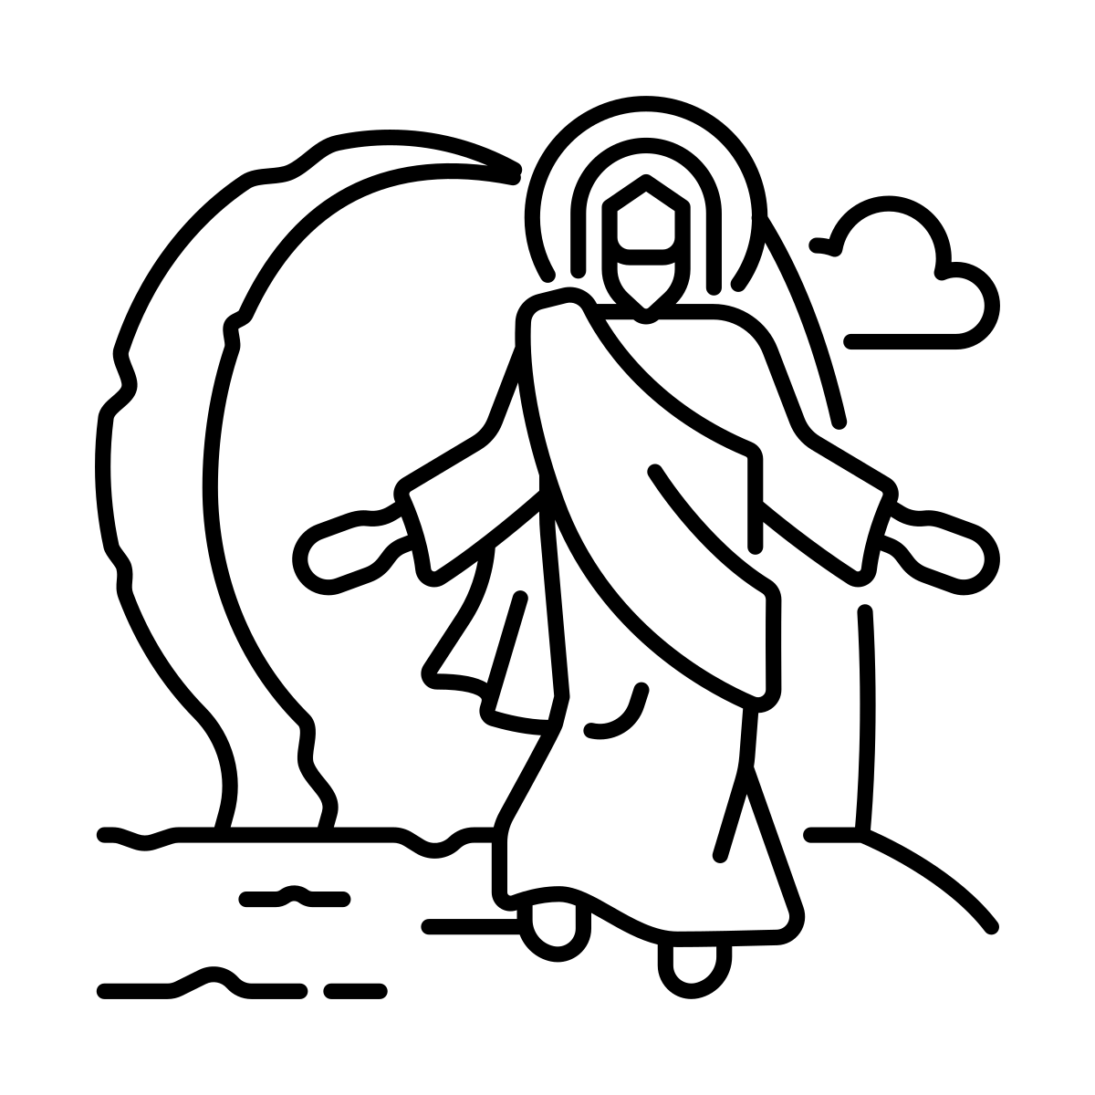
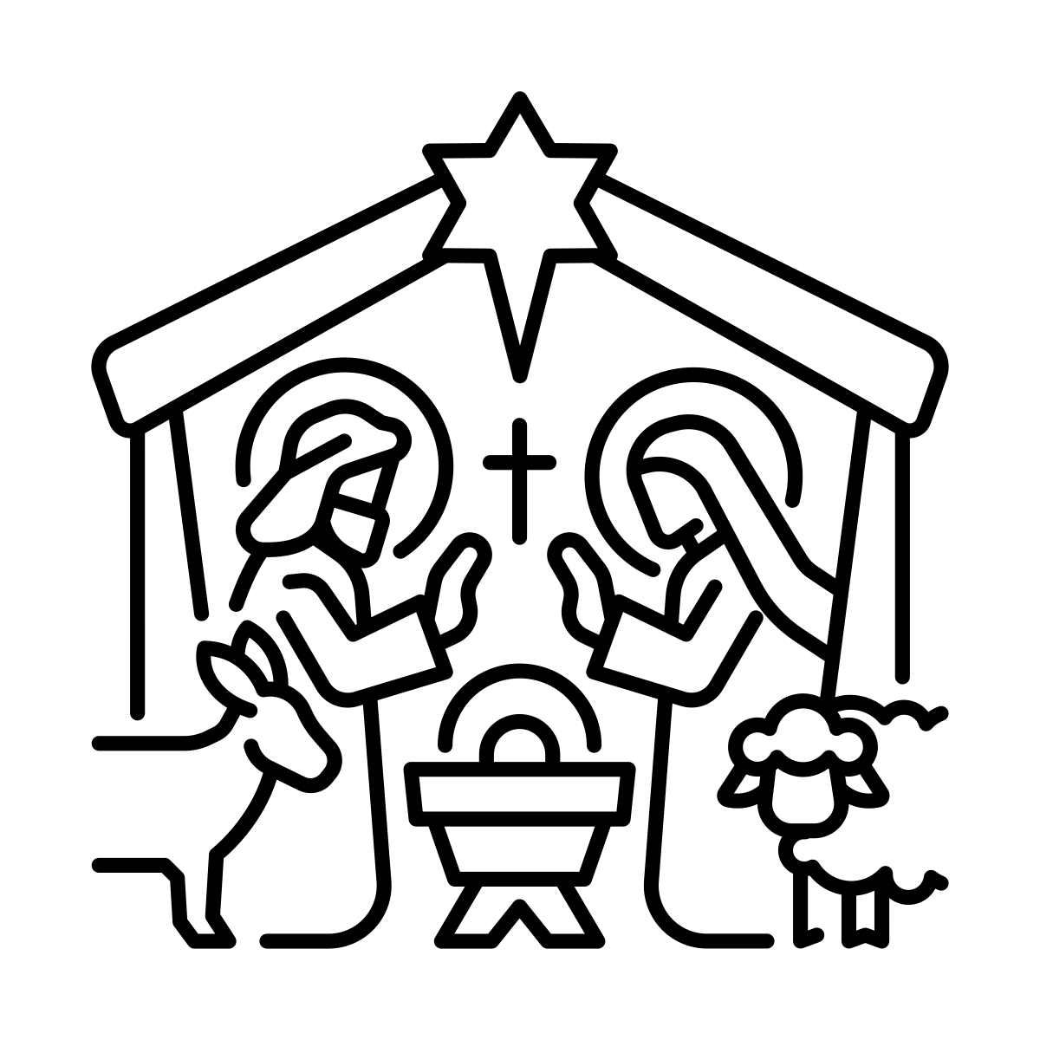
Christians believe they can TRUST God’s promises because He has shown we can trust him. He promised He would send a Saviour, and Christmas and Easter show that He keeps this promise.

Slide 14

Where do you personally stand on these promises?
Do you trust God enough to give Him your vote; which we do in our hearts rather than putting a cross on a piece of paper?
Christians believe He voted for us with a cross on a hill.

Slide 15
Prayer
God
Thank you for your promises to us.
Strengthen us in our faith in you – help us to trust in you and all that you do for us in this time, in this place.
Amen

