Slide 1

Add new branding
Week Five, Plan One

Slide 2


Jacob’s Ladder (Genesis 28: 10-22)

Slide 3


Slide 4


Slide 5


Slide 6
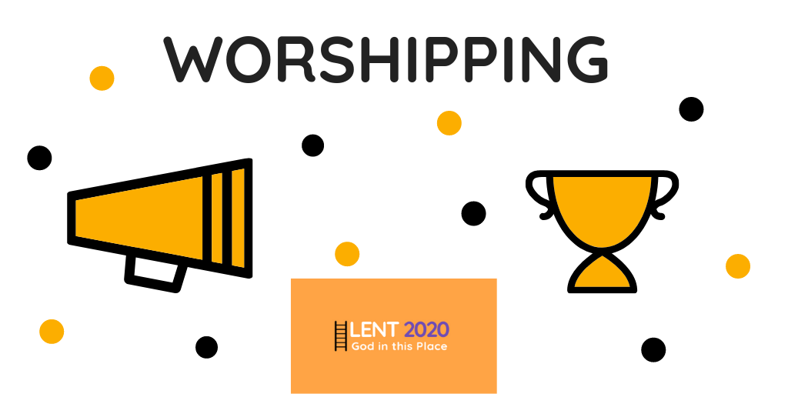

Slide 7
We have collective worship every day, but what does ‘worship’ mean?
What images come into your head when you hear the word worship?

Slide 8
‘Worship’ comes from the Anglo-Saxon word ‘worthshippe’. It is showing worth to something or someone.
I wonder, what do you think people give the most worth to in the world today?
Does this understanding of ‘worship’ differ to our initial ideas?

Slide 9
For many people, worship is showing worth to God.
Where can this type of worship take place?

Slide 10
Is it just in places of worship, such as a church, or school hall?
How could actions on the playground, how people treat others or the planet etc. also be seen as showing worth to God?

Slide 11
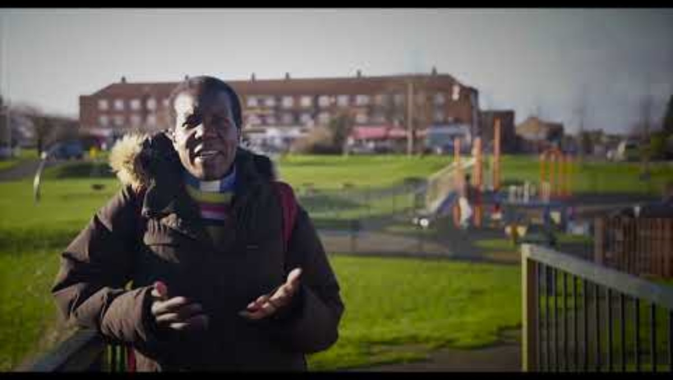
HP to embed Week 5 VLOG

Slide 12
When Jacob awoke from his sleep, he thought, “Surely the Lord is in this place, and I was not aware of it.”
Jacob had ‘boxed’ God. He had decided that God could be found at certain times and places, but was not with him at other times of his life. Through his dream, Jacob began to realise that God was with him in all parts of his life.

Slide 13
I wonder:
What do we show to most worth to as a school?
Where is worship happening in the school?
Is it just seen when we meet together like this? Or can worship be seen at other times and places?

Slide 14
Prayer
God,
Thank you for being with us at all times and in all places
Help us to worship you with all we think, say and do
Amen

