Slide 1

Week Five, Plan Two

Slide 2
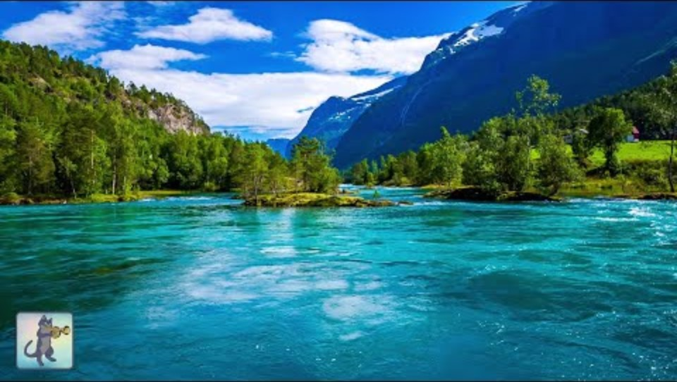

Slide 3
Then Jacob woke from his sleep and said, ‘Surely the Lord is in this place— and I did not know it!’ And he was afraid, and said, ‘How awesome is this place! This is none other than the house of God, and this is the gate of heaven.’ So Jacob rose early in the morning, and he took the stone that he had put under his head and set it up for a pillar and poured oil on the top of it. He called that place Bethel.
Genesis 28: 16-18a

