Slide 1

Add newbranding
Week Five, Plan Two

Slide 2
I wonder what you thought about listening to that music as we gathered?
I wonder how you felt?

Slide 3
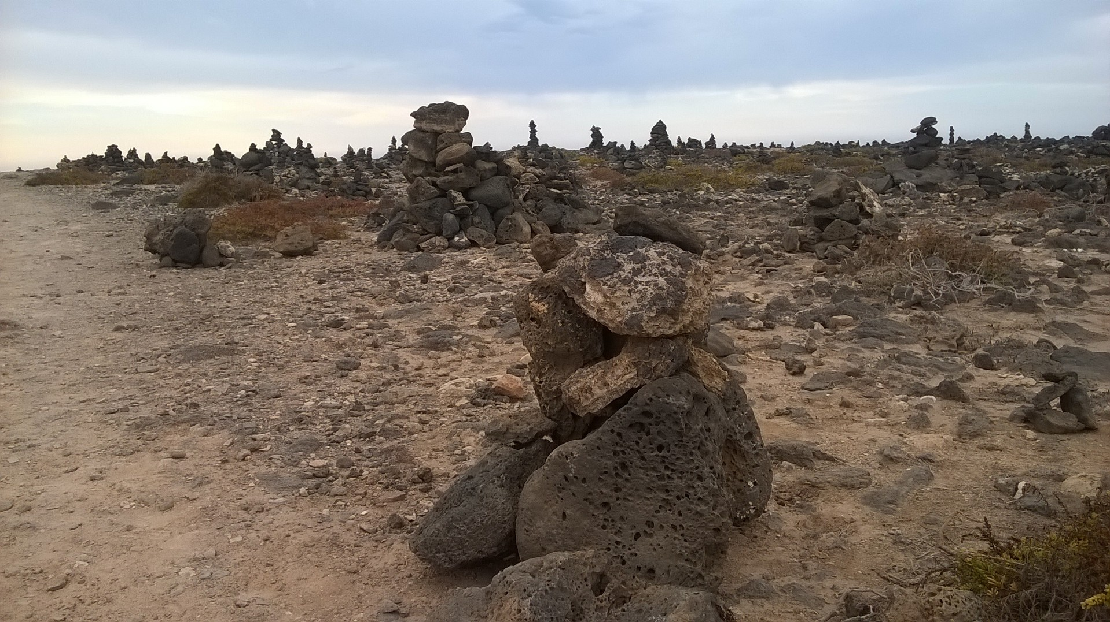

Slide 4
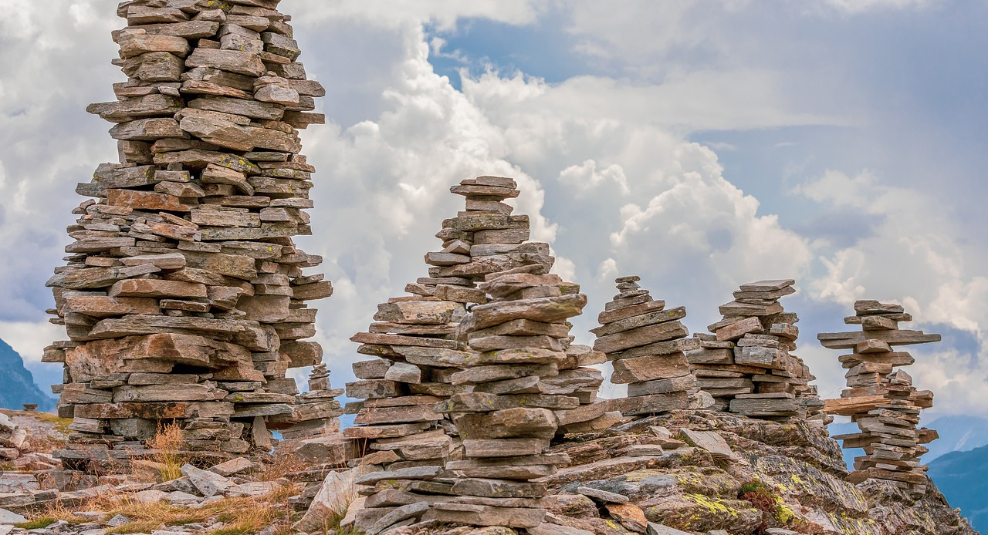

Slide 5
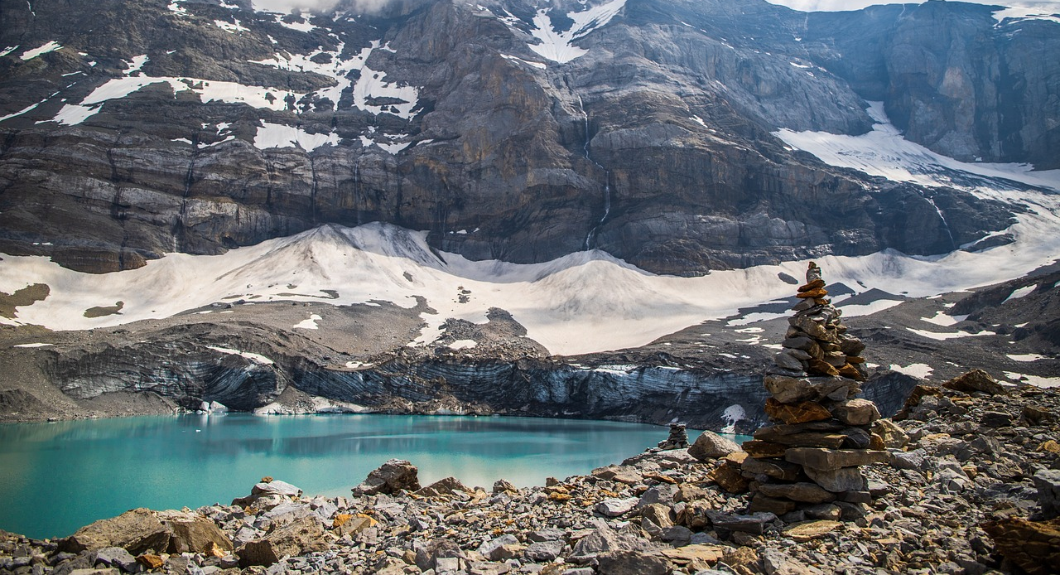

Slide 6
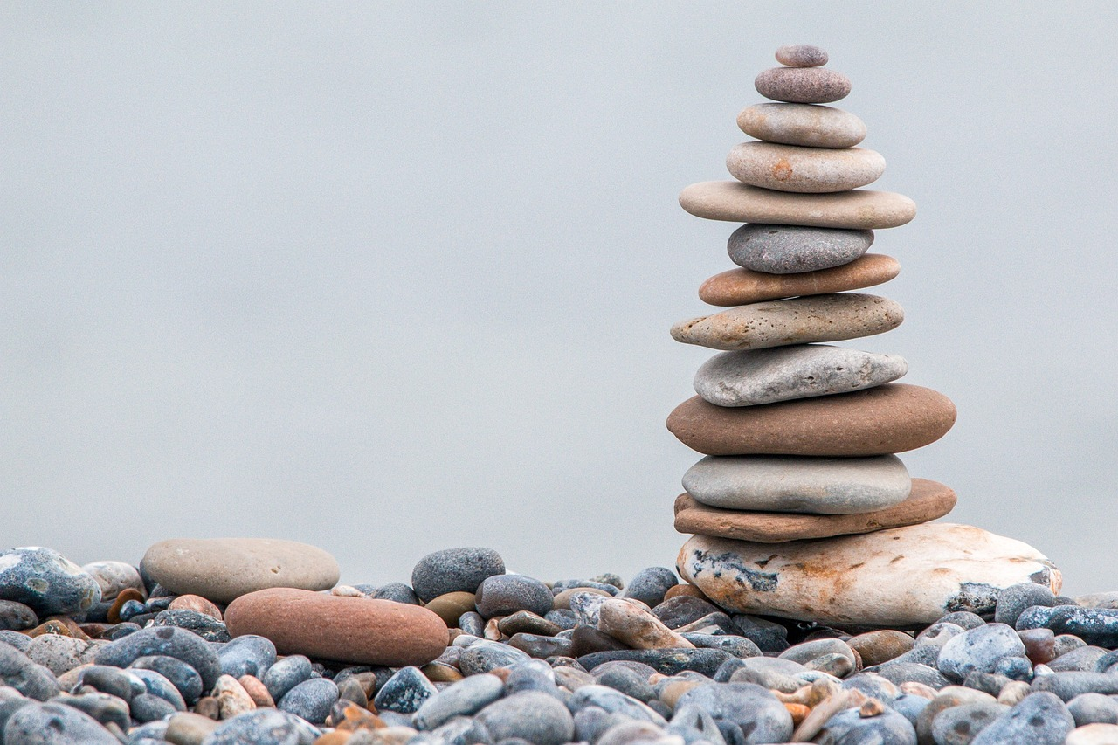

Slide 7
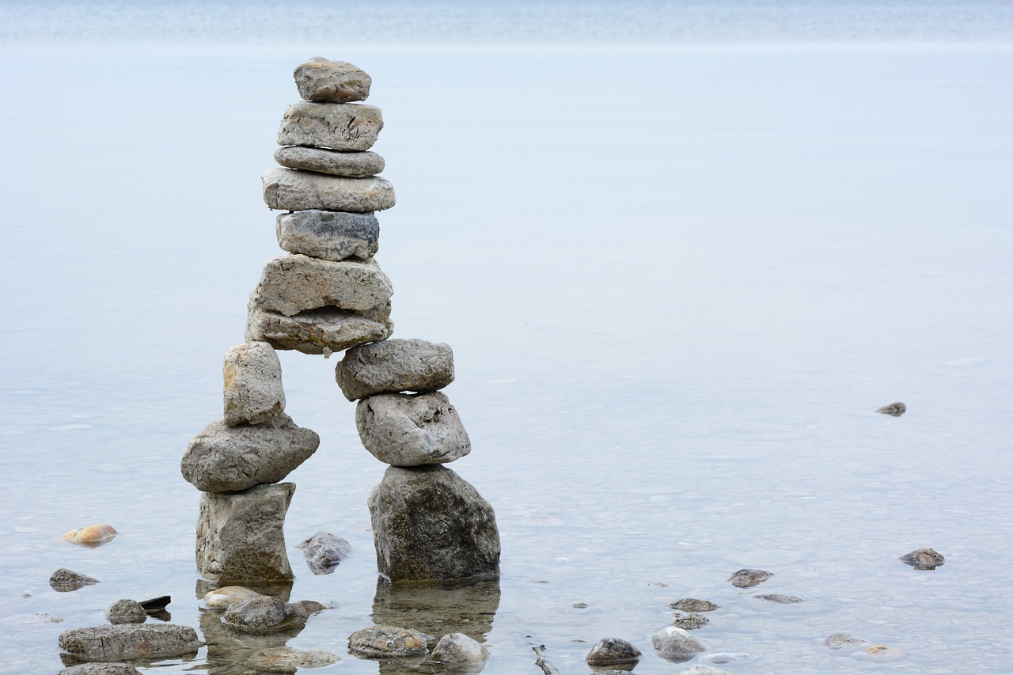

Slide 8
