Slide 1

Week Five, Plan Three

Slide 2
Worship
‘showing worth’

Slide 3
Different people show worth to God in different ways. E.g.:
Praying to God in a quiet place
Through loving and caring for others
Through reading sacred texts/wisdom, such as the bible
Through using gifts and talents to make the world a better place for others
Through looking after the world (e.g. litter picking)
Through joining with other worshippers to celebrate and learn more about God (e.g. at church)

Slide 4

What is courageous advocacy?

Slide 5
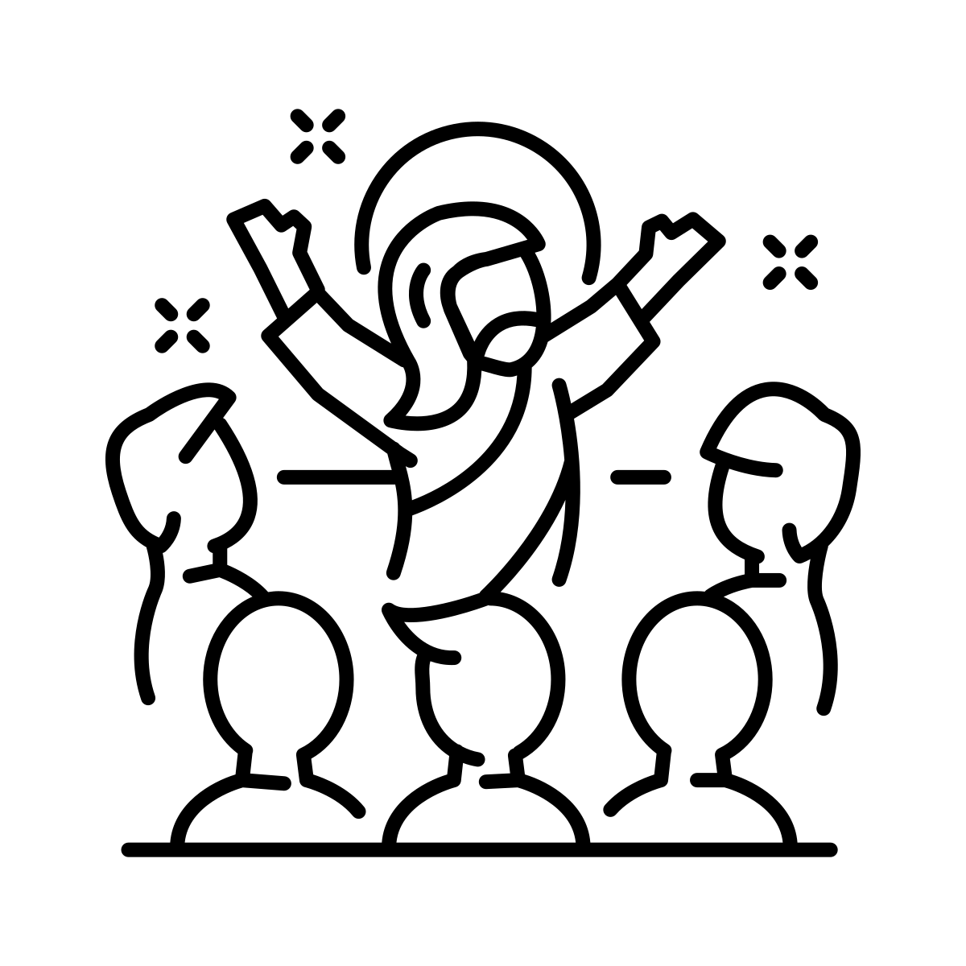
For many, worship and social action are interlinked. Many Christians believe this is seen clearly through the life and teachings of Jesus, as his lived his message of love and dignity of all in making a difference 2000 years ago.

Slide 6


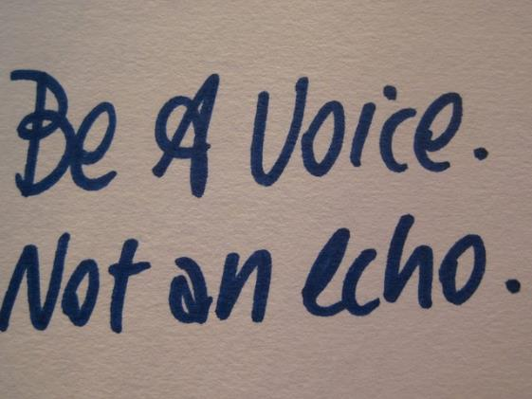

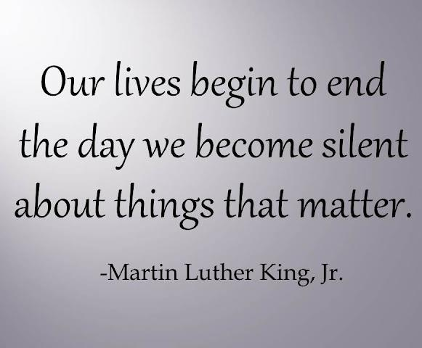
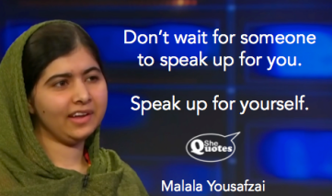

Slide 7
Micah 6:8
What does the LORD require of you? To act justly and to love mercy and to walk humbly with your God.
I wonder what we need to make a stand for to ensure human flourishing?

Slide 8
We need to make a stand for…

Slide 9
As we leave this place, I wonder what you will make a stand for this year?
Will this be a way you worship?
Prayer:
Lord, you give us the unwavering call to do justice.
You tell us to defend the cause of the oppressed
To provide for the hungry and thirsty
To love our enemy.
May your Spirit fill us with hope.
Remind us that we are good enough for you, so that in all things, we will follow your will, and take up the call to do justice, to love mercy, and to walk humbly with you.
Amen

