Slide 1

Add new branding
Week Five, Plan Three

Slide 2
Worship
‘showing worth’

Slide 3
Different people show worth to God in different ways. E.g.:
Praying to God in a quiet place
Through loving and caring for others
Through reading sacred texts/wisdom, such as the bible
Through using gifts and talents to make the world a better place for others
Through looking after the world (e.g. litter picking)
Through joining with other worshippers to celebrate and learn more about God (e.g. at church)

Slide 4

What is courageous advocacy?

Slide 5
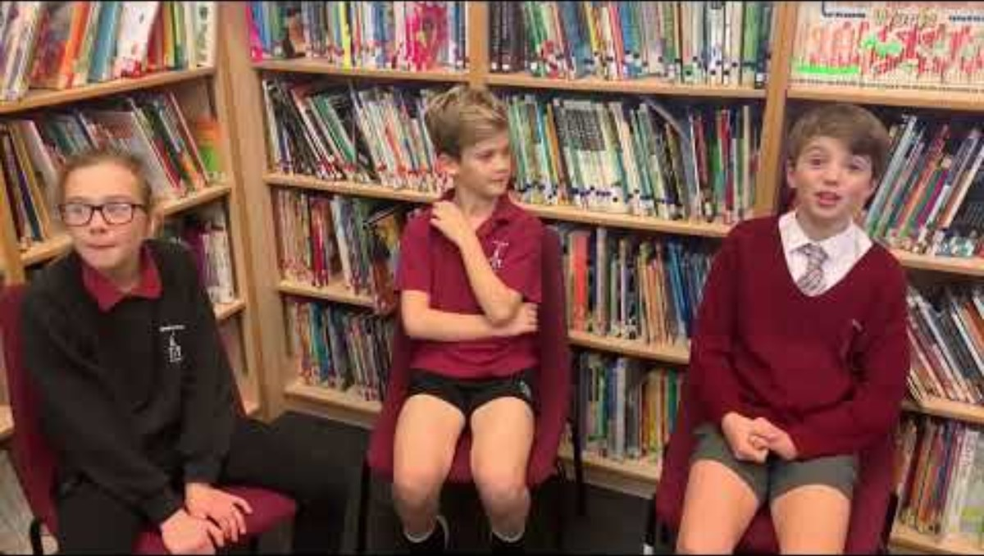

Slide 6
How could we stand up to make the world a better place?
Could this be seen as worship?

Slide 7


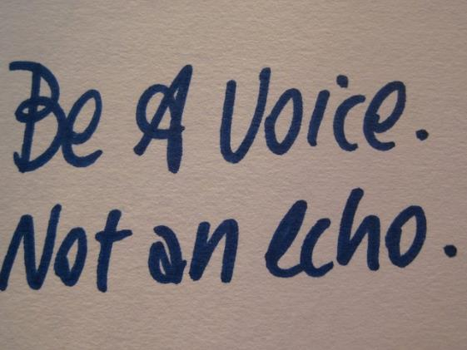

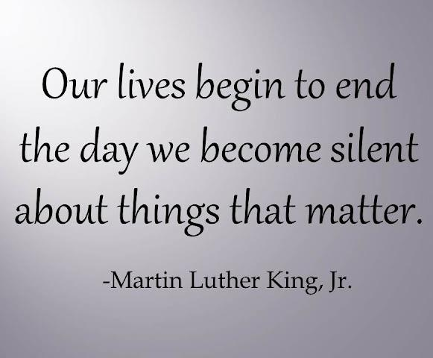


Slide 8
Prayer
Lord, Inspire and grant us the courage to stand up for what is right and make the world a better place for all.
Amen.

