Slide 1

Add new branding
Week Six, Plan One

Slide 2


Jacob’s Ladder (Genesis 28: 10-22)

Slide 3


Slide 4


Slide 5


Slide 6


Slide 7


Slide 8
‘If…’
I wonder how often we have tried to bargain with family and friends?
If you do this, I will…
I will be your friend, if you…
I will forgive you, if…
I wonder if this has ever happened to you? People have set conditions on you in order to restore/maintain a relationship.
I wonder how it made you feel?

Slide 9
In the story of Jacob, Jacob tried to make a bargain with God.
Then Jacob made a vow, saying, "If God will be with me and will watch over me on this journey I am taking and will give me food to eat and clothes to wear so that I return safely to my father’s household, then the Lord will be my God and this stone that I have set up as a pillar will be God’s house, and of all that you give me I will give you a tenth." (Genesis 28: 20-22)

Slide 10
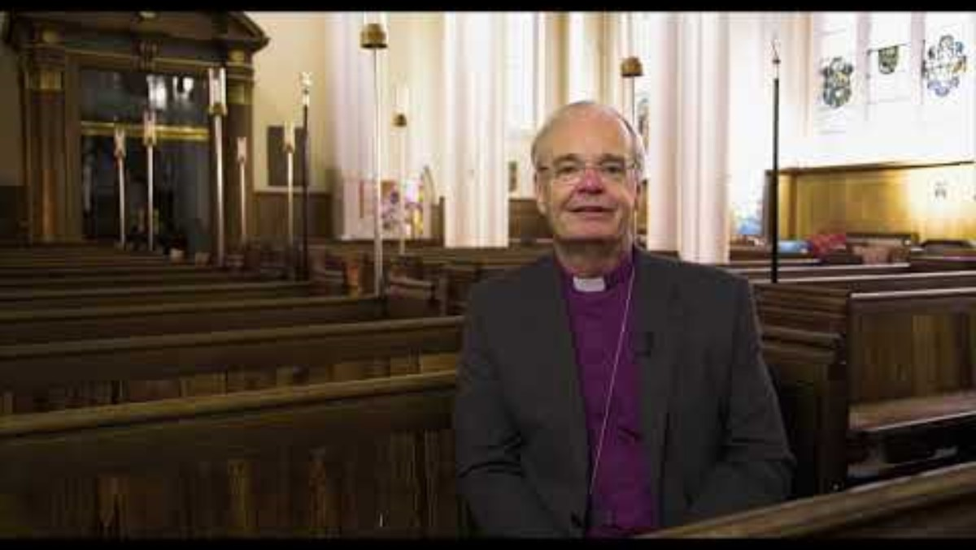
HP to add VLOG

Slide 11
Let’s hold a time of quiet reflection.
I wonder how often we have made bargains or conditions in our own relationships?
    With friends?
    Family?
    God?
Do we love conditionally, or unconditionally?
Notes:
E.g. 'You can be my friend if you like these hobbies, wear these clothes, listen to this music…', 'I will help at home if…?', 'I will worship you, God, if…?’

Slide 12

…

