Slide 1

Add new branding
Week Six, Plan Two

Slide 2


Jacob’s Ladder (Genesis 28: 10-22)

Slide 3

Question: What is the longest journey any human being has ever made?
Answer: To the Moon

Slide 4
https://www.nasa.gov/mission/apollo-11/
https://www.youtube.com/watch?v=xi_3GtQN2IA

Slide 5
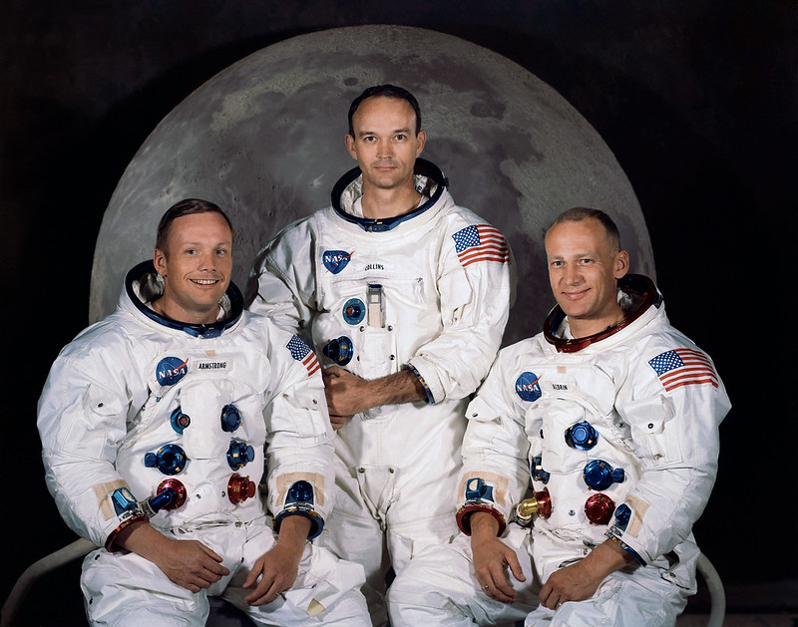
Mission Objective: The primary objective of Apollo 11 was to complete a national goal set by President John F. Kennedy on May 25, 1961: perform a crewed lunar landing and return to Earth.
Crew:
Neil Armstrong, Commander
Edwin E. Aldrin Jr., Lunar Module Pilot
Michael Collins, Command Module Pilot
Duration: Eight days, three hours, 18 min, 35 seconds
Distance: 953,054 miles
Lunar Location: Sea of Tranquillity

Slide 6
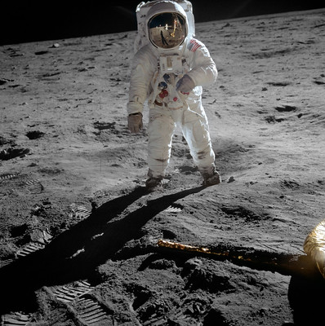
When Neil Armstrong became the first person to walk on the moon, he said, "That's one small step for (a) man; one giant leap for mankind."
Those men were also men of faith and they believed that God journeyed with them.
https://www.flickr.com/photos/nasamarshall/with/53952618868; https://creativecommons.org/licenses/by-nc/2.0/

Slide 7

www.bbc.co.uk/programmes/p07h9ywk

