Slide 1

Add new branding
Week Six, Plan Three

Slide 2
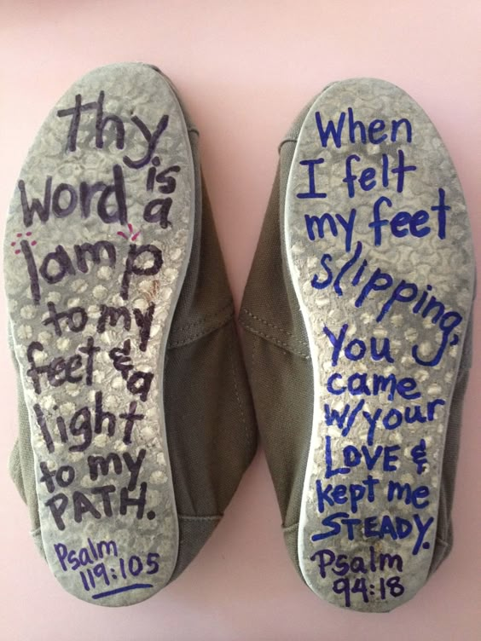
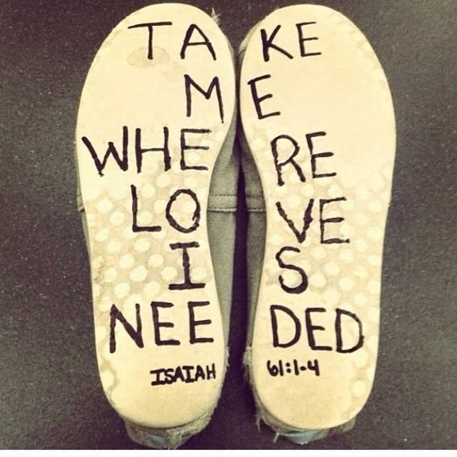

Slide 3
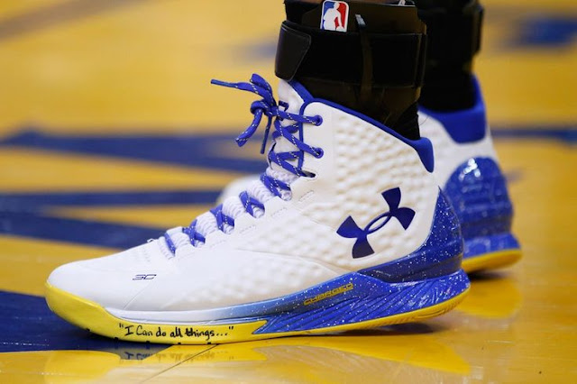
I can do all things through
Christ who strengthens me.
Philippians 4:13
https://www.catholicnewsworld.com/2016/03/wow-message-on-shoes-of-basketball-star.html

Slide 4
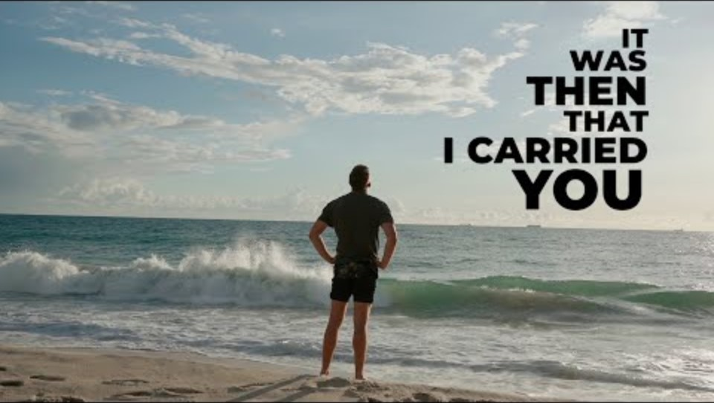

Slide 5


Slide 6


Slide 7


Slide 8


Slide 9


Slide 10
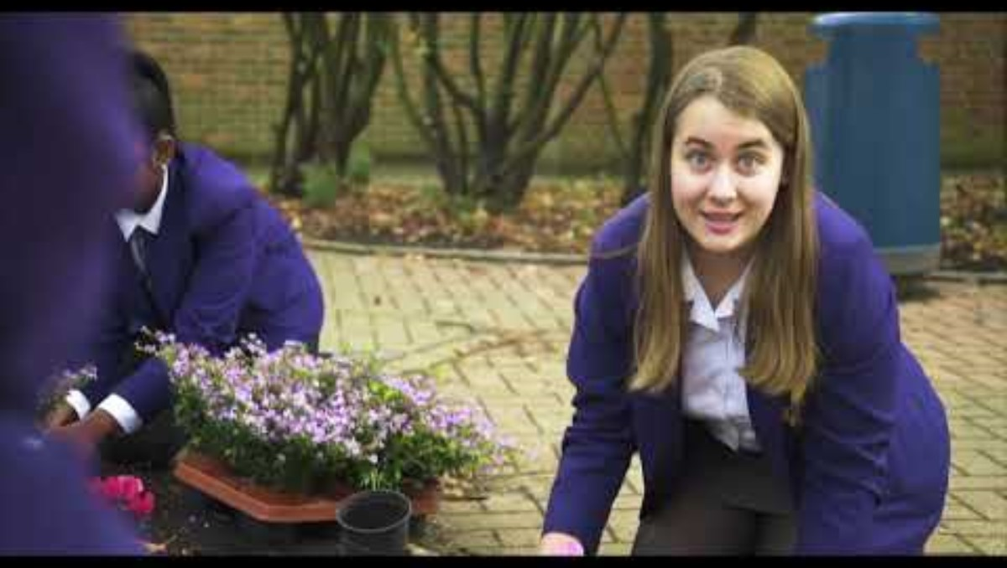
HP to add GITP outro video

Slide 11
God
Thank you for the opportunity we have had to think deeply through Jacob’s dream.
We thank you that you are in this place and all places we find ourselves in.
Help us to recognise you with us as we journey through life.
Amen

