Slide 1

Week Six, Plan Three

Slide 2

When you go on holiday what do you pack?
If you had to leave home in a hurry, what would you pack?

Slide 3
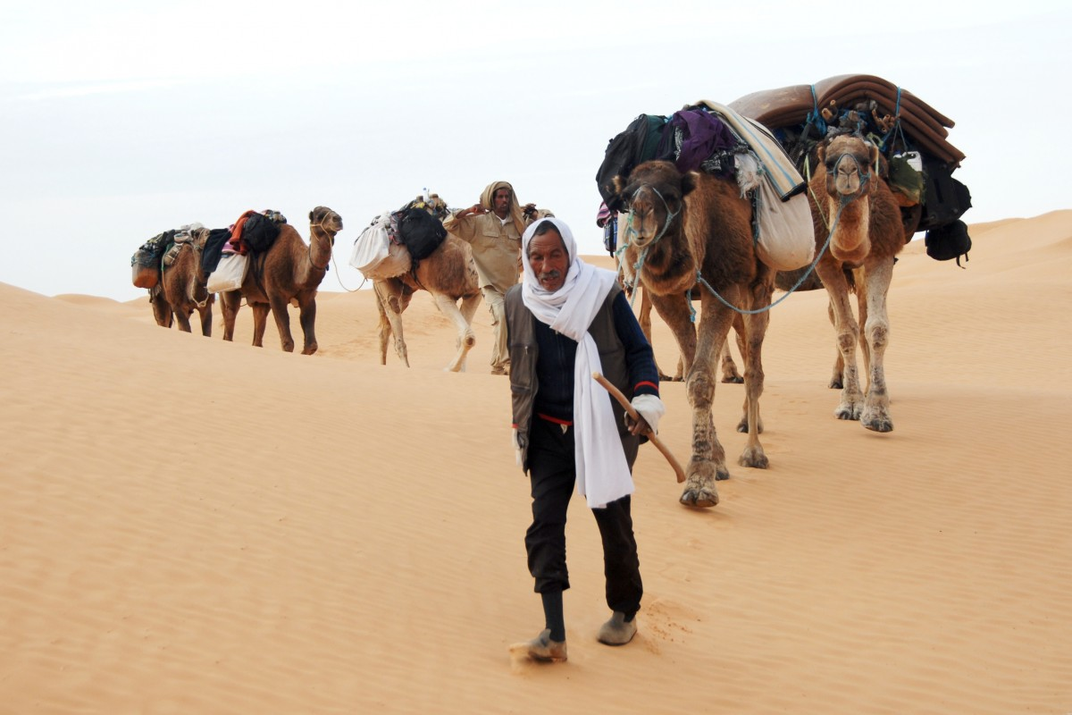
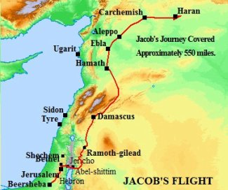
"Jacob set off on his long journey away from his elder brother, Esau, who hated him for taking his father’s blessing which should have been his as the first born. So he was rather afraid. He needed to get out quick, but he was going to have a make a long journey to his distant family headed by his distant uncle Laban whom he did not know.”
https://atozmomm.com/tag/map-of-haran/

Slide 4

What would you pack on your camel to take? Given that you have to eat and drink and that the journey will take a long time.
What do you think are the most important items Jacob could take?

Slide 5


What skill(s) do you have that you think might help you on your journey of life?

Slide 6
The luggage that we carry on our journey of life we carry within us, just like a skill. Some of that luggage can be useful, some of it can just get in the way. This kind of “inside” luggage we call values. Some values can be useful and help us along our journey, but some values can just get in the way and can cause us to stumble on the way.
Let’s list some good values that are worth making sure we take with us on our journey of life, and let's also list some bad values that we could with just throwing down the nearest well.

Slide 7
"The most important journey we will ever make is the journey of our life, so the luggage values we take with us are very important."
I wonder…
What do you think is the most important value for you?
What positive values do you want to take on your life journey?

Slide 8


Slide 9


Slide 10


Slide 11


Slide 12


Slide 13
