Slide 1

Collective Worship - ‘Day 1’, Plan 2

Slide 2

What would a world that didn’t have electricity be like?

Slide 3
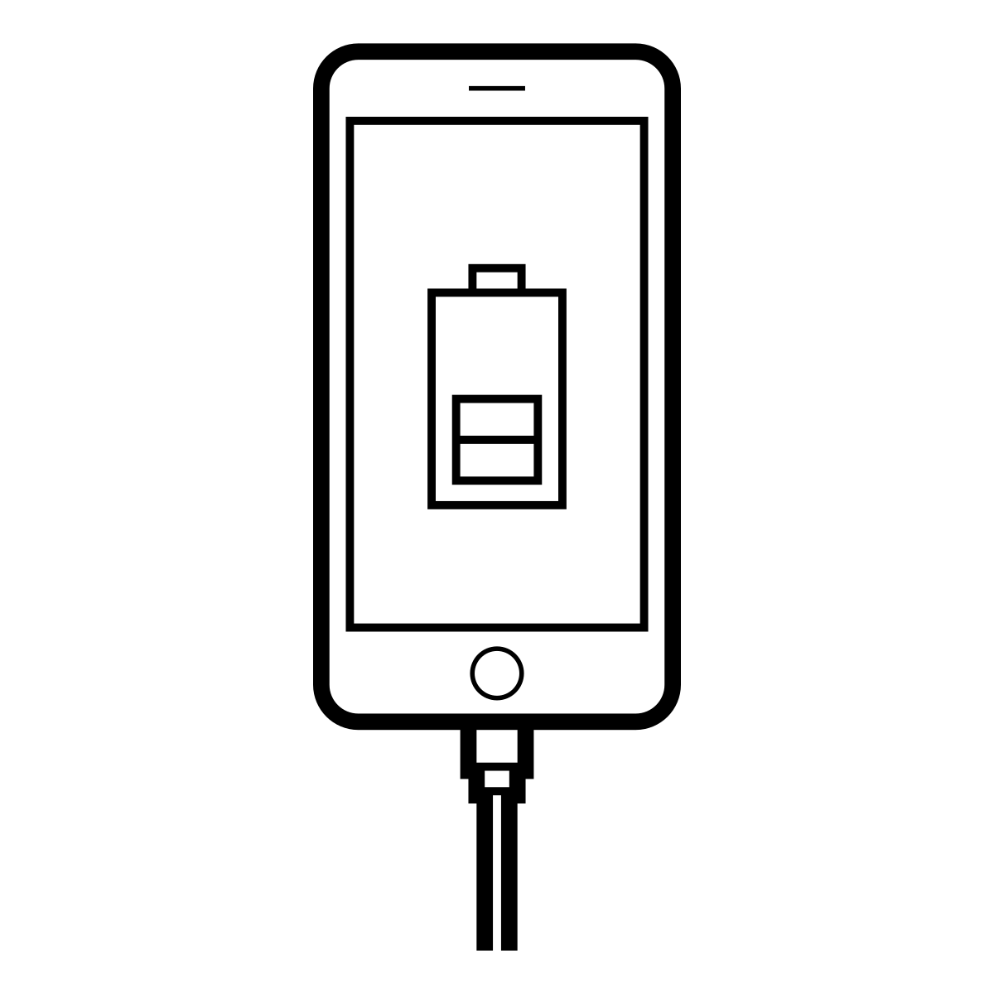
True or false?
Only 5% of the power drawn by a phone charger is used to charge the phone

Slide 4
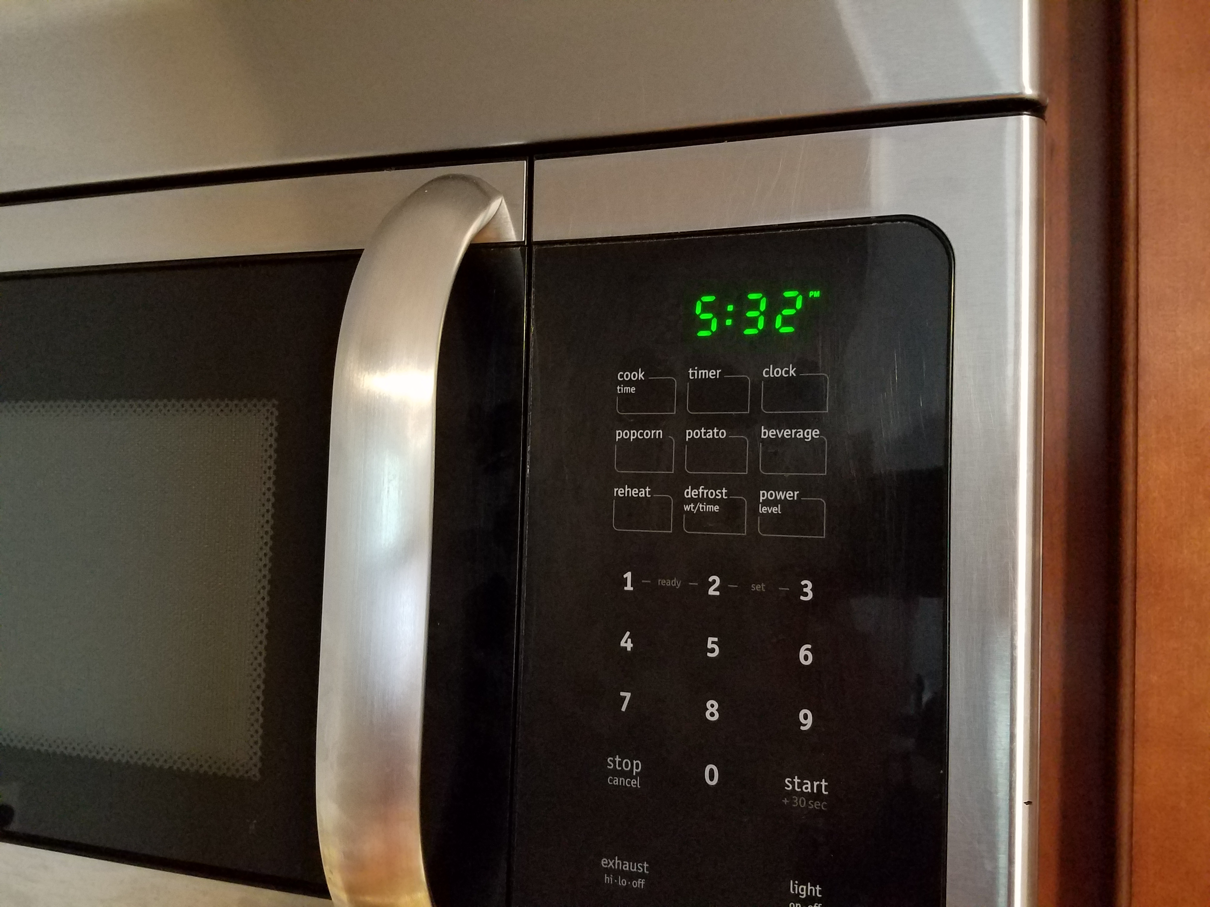
True or false?
A typical microwave uses more electricity heating food than it does to show its digital clock
https://commons.wikimedia.org/wiki/File:Frigidaire_microwave_clock_20200418.jpg

Slide 5


True or false?
In the average home, 75% of the electricity used to power electronics is used while the products are turned off (on standby)

Slide 6

True or false?
If everyone boiled only the water they needed every time they used the kettle, we could save enough electricity in a year to power the UK’s street lights for 3 months

Slide 7
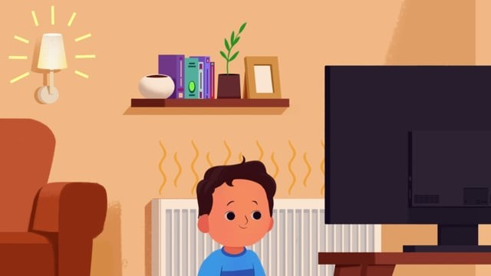
I wonder if there is anything that surprised you here?
Let’s watch this video which focuses on simple things we could do to save energy around the house:

Slide 8





Let’s think back to our first ‘Heart for the Earth’ collective worship. Here, we thought about two different views:
God
God
Dominion worldview
‘Community of creation’ worldview

Slide 9



It is here that we can go a little bit deeper and think about three things when it comes to showing a heart for the earth – head, hearts and hands.
Heads: I wonder how we see the world and humanity’s place within it? What difference might this make?
Hearts: what are we hopeful for? What kind of future do we want to see for us and the planet which we share?
Hands: how might we show a heart for the earth in our own lives? What will we do to show a heart for the planet and all life upon it?

Slide 10
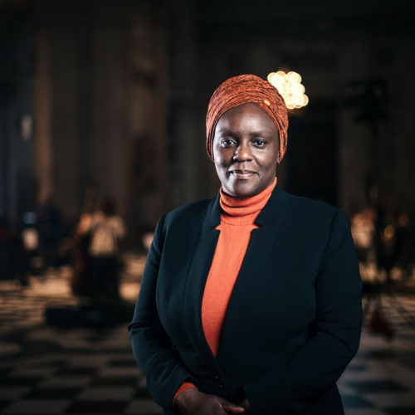
‘The scale of the emergency facing our world demands a just response from every one of us…heads, hearts and hands in meeting this crisis. It is only together that we can make a difference’
Amanda Khozi Mukwashi, CEO of Christian Aid
https://mediacentre.christianaid.org.uk/amanda-khozi-mukwashi-to-step-down-as-christian-aid-ceo/

Slide 11
I wonder how we can show a heart for the earth through wise use of electricity?
I wonder how we might encourage and support one another in this area?

Slide 12
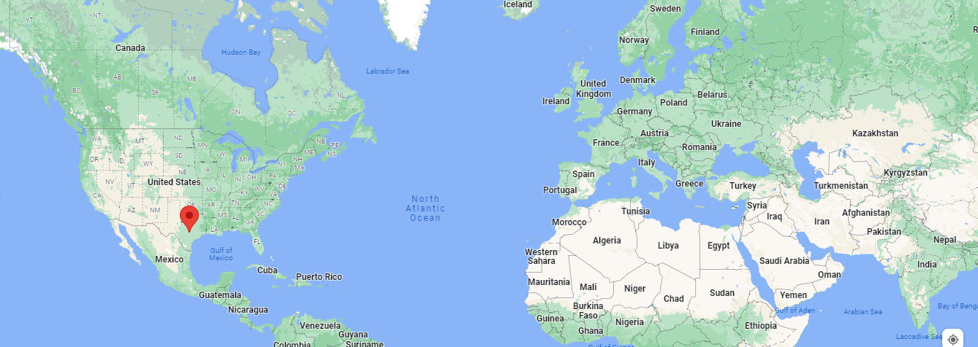
A prayer from AllCreation.org, founded in Austin, Texas (http://www.allcreation.org/home/christian-prayers):
‘Loving Father and Creator of all we come to you today deeply grateful for your creation. As we look around us we are amazed at the greatness and majesty of all that you have made. Nature around us speaks of your greatness - the vast expanse of the sky, the mountains, trees, lakes and streams speak of your great design. You have given us such beauty in the colors of the rainbow, the beauty of flowers and fields. Words cannot adequately express the magnificence of all you have created...May we show our love and reverence to you, our Lord, by caring for all that you have created. We humbly give you praise and thanks. Amen.’
https://www.google.com/maps/place/Austin,+TX,+USA/@37.8673308,-28.1820707,3z/data=!4m5!3m4!1s0x8644b599a0cc032f:0x5d9b464bd469d57a!8m2!3d30.267153!4d-97.7430608

Slide 13

‘If not me, then who? If not now, then when?’

