Slide 1

Collective Worship - ‘Day 2’, Plan 2

Slide 2

How many litres of water do you think the average British person uses per day?
20 litres
150 litres
4,653 litres

Slide 3
How many litres of water do you think the average British person uses per day?
20 litres
150 litres (‘direct water’)
4,653 litres (‘virtual water’)

Slide 4

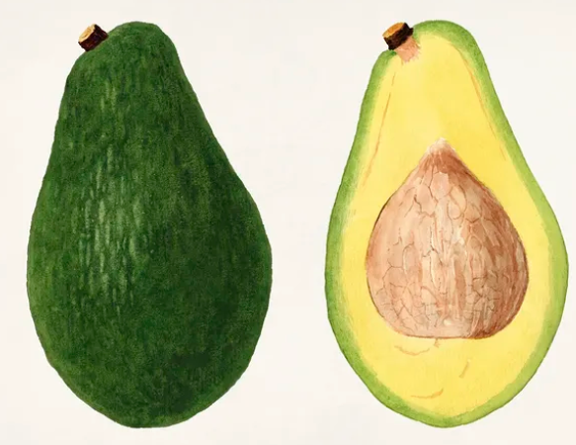
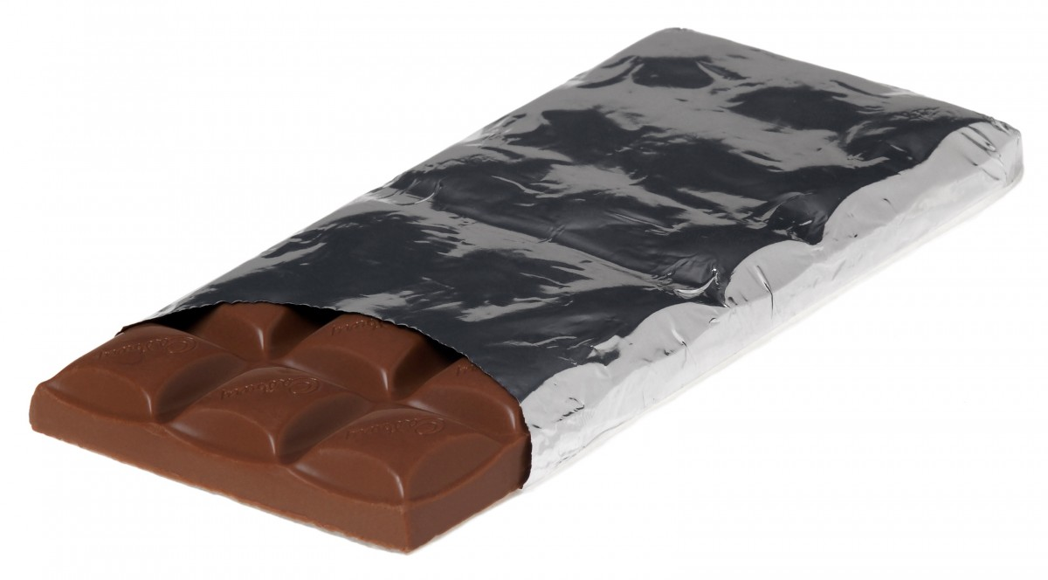

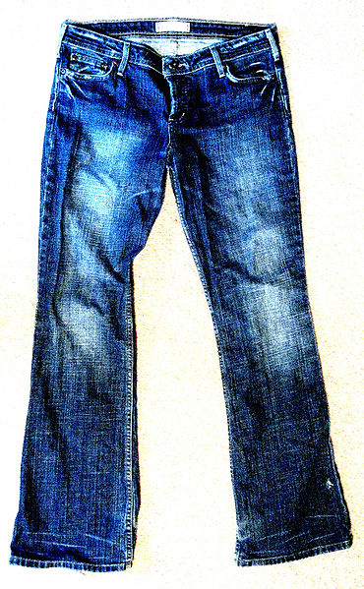
How many litres do you think it takes to make the following?
A single almond
An avocado
A large chocolate bar
A cotton shirt
A pair of jeans
(12 litres)
(272 litres)
(1700 litres)
(3000 litres)
(9500 litres)

Slide 5

Our water is not unlimited. Around 99% of the world’s water is locked in ice-caps, glaciers or is too salty to drink. There is only 1% of the Earth’s water that is usable for all of humanity’s needs – agricultural, manufacturing, residential and living needs. We need to think about how we can be wise users – not abusers – of water.
The water that we use needs to be cleaned so that it can be used once again. Cleaning water uses energy. As we use so much water, the greatest energy user in our region (East of England) is Anglian Water.
Let’s listen to Ellie and Marcia as they explain what happens at one of their wastewater treatment plants.

Slide 6
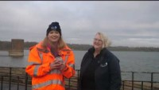
https://youtu.be/JXv7nnZCdbs

Slide 7
I wonder how we could all show a heart for the Earth through our wise use of water?
We praise and thank You, Lord,
for the gift of living water.
Guide us
to use it wisely,
learn from its humility,
consume it sparingly,
and protect its purity,
so we may truly enjoy water.
Amen.
(Written by Cathal Duddy, Ireland)

Slide 8

A challenge…
I wonder how we all could show a heart for the Earth through wise use of water this week and ‘Love Every Drop’?
If we all played our part, think how many litres of water (and energy) we could save!

