Slide 1

Collective Worship - ‘Day 1’, Plan 1

Slide 2

I wonder what you think this image might be about?
What does it make you think of? How does it make you feel?

Slide 3

We are going to think about the first creation story found in the Bible – Genesis 1.
I wonder what you think the main messages people take from this narrative are?

Slide 4
For thousands of years the creation narrative of Genesis 1 has been read by millions of people. Some of the main messages taken are…
…that the world has been created by God. God chose to create plants, animals, humans, birdlife, sealife, land and sky.
…and this creation is good! The world is full of so much beauty, amazing life and places.
What parts of the world do you really love which make you go ‘wow’?

Slide 5





God spoke: “Let us make human beings in our image, make them reflecting our nature so they can be responsible for the fish in the sea, the birds in the air, the cattle, and, yes, Earth itself, and every animal that moves on the face of Earth.” (The Message version)
God
God
Dominion worldview
‘Community of creation’ worldview

Slide 6
These views are important to think about in the light of climate change.
What is climate change? What are some of the impacts of climate change?
Which view below do you think is better for responding to climate change and showing a heart for the earth?
God
God
Dominion worldview
‘Community of creation’ worldview

Slide 7
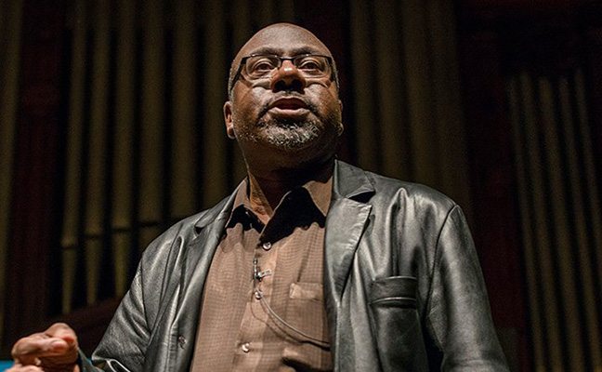
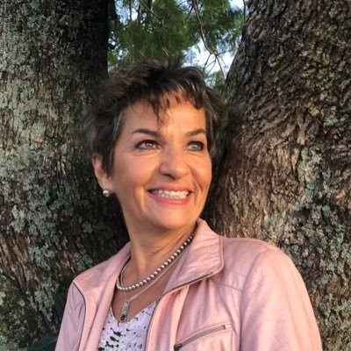
‘To be human is to care for creation’
Anthony G Reddie
https://www.greenbelt.org.uk/artists/anthony-reddie/
‘Know that you are incredibly lucky to be alive at a time when you can make a transformative difference to the future of all life on Earth. You are not powerless. Your every action is suffused with meaning and you are part of the greatest chapter of human achievement in history’.
Christiana Figueres

Slide 8
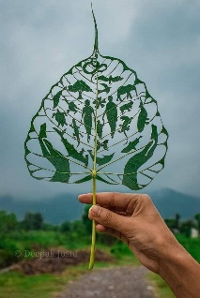
Do you think it is important to show a
heart for the earth? Why?
How might you show a heart for the earth in your thoughts and actions?

Slide 9
Dear God,
Thank you for creating the world and everything in it
Forgive us for those times in which we have put ourselves before creation
Help us to show a heart for the earth in our thoughts and actions this week
Amen

